Slide 1

Protecting workers at risk of histoplasmosis

Slide 2
What Workers Should Know about Histoplasmosis
Histoplasmosis is an infection caused by a fungus called Histoplasma capsulatum.
Endemic in areas around the Ohio and Mississippi River Valleys.
The fungus lives in the environment, particularly soil that contains large amounts of bird or bat droppings.
People can get histoplasmosis after breathing in the very small fungal spores
(also known as conidia) from the air.

Slide 3
Some activities have risks for exposure to Histoplasma
Disturbance of large accumulations of bird or bat droppings (scraping droppings from a bridge, shoveling droppings from a building, cleaning achicken coop)
Demolition, construction, or renovation
Soil disruption (digging or excavation)
Plant matter disruption (handling trees, landscaping)
Working in caves

Slide 4
Protecting workers
Prevent the accumulation of bird or bat droppings by excluding bats and birds from buildings.
If accumulations of bat or bird droppings must be removed or if you are doing construction, excavation, or demolition in areas where Histoplasma is common, try to eliminate or reduce dust.
spraying dry, dusty material with water instead of shoveling or sweeping
Adding a surfactant or wetting-agent to the water might further reduce the aerosolization
Industrial vacuum cleaner with a high-efficiency filter to collect potentially contaminated material
Personal protective equipment (PPE) may also help protect from Histoplasma.
Disposable protective clothing and shoe coverings can help prevent spreading spores to other places like your car or home

Slide 5
Protecting workers
Safe disposal of waste: Any material removed from a work site that might be contaminated with Histoplasma should be disposed of properly and safely and should not be moved to another area where it could still be a health hazard.
Potentially contaminated materials should be disinfected

Slide 6
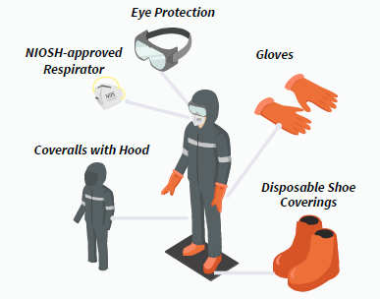
Notes:
respirators must be National Institute for Occupational Safety and Health (NIOSH)-approved

Slide 7
If there’s exposure to Histoplasma
Contact the occupational Health or Risk Management Department
Contact your local city, country, or state health department
Seek a medical evaluation by a healthcare provider
Talk to your healthcare provider about testing for histoplasmosis

Slide 8
Prevention of exposure in the lab
The laboratorian should have knowledge of the facility laboratory safety manual
Laboratorian training
Medical surveillance
Containment of microbial exposures through aseptic microbiological practices
All clinical and culture samples should be handled in a biosafety level (BSL)-3 laboratory
Taping of culture plates can also minimize exposure

Slide 9
Administrative controls
Develop a site safety plan to minimize workplace exposures.
Reduce or eliminate dust.
Post health risk warnings in areas known or suspected to be contaminated with Histoplasma.
Hazard Communication and Training: signs and symptoms, risk factors, treatment, and how to prevent exposures.
Provide PPEs
Respirators must be National Institute for Occupational Safety and Health (NIOSH)-approved
Encourage workers with workplace exposures to Histoplasma or symptoms of histoplasmosis to seek a medical evaluation with a healthcare provider

Slide 10
THANK YOU

