Slide 1


Histoplasmosis

Slide 2
Case reports

Slide 3
Case 1
A 69-year-old female working at construction sites (carrying loads)
She also works in farms
Presented with 2 months of shortness of breath, dry cough, subjective fevers, and an unintentional 8kg weight loss
Review of symptoms was also notable for constant, diffuse headaches and nausea without vomiting or abdominal pain
Multiple sexual partners in the past, but presently monogamous

Slide 4
Case 1: clinicals
On physical examination;
Afebrile and saturating 100% on room air
Frail and appeared chronically ill
Lungs were clear upon auscultation bilaterally

Slide 5
Preliminary lab results
Pancytopenia, with a WBC of 3.82 × 10⁹/liter (4.22 × 10⁹ to 10.33 × 10⁹/liter)
hemoglobin of 8.1 g/dl (13.2 to 16.9 g/dl),
platelet count of 31 × 10⁹/liter (160 × 10⁹ to 383 × 10⁹/liter),
hyponatremia, with a sodium conc of 124 mmol/liter (135 to 145 mmol/liter)
elevated ferritin level of 57,180 ng/dl (30 to 400 ng/ml)

Slide 6
More lab results
Retroviral screening - HIV type 1 (HIV-1) and HIV-2 antibodies and p24 antigen was positive
CD4 count of 29 cells/μl (365 to 1,437 cells/μl)
HIV load of 720,440 copies/ml.
TB-LAM - negative

Slide 7
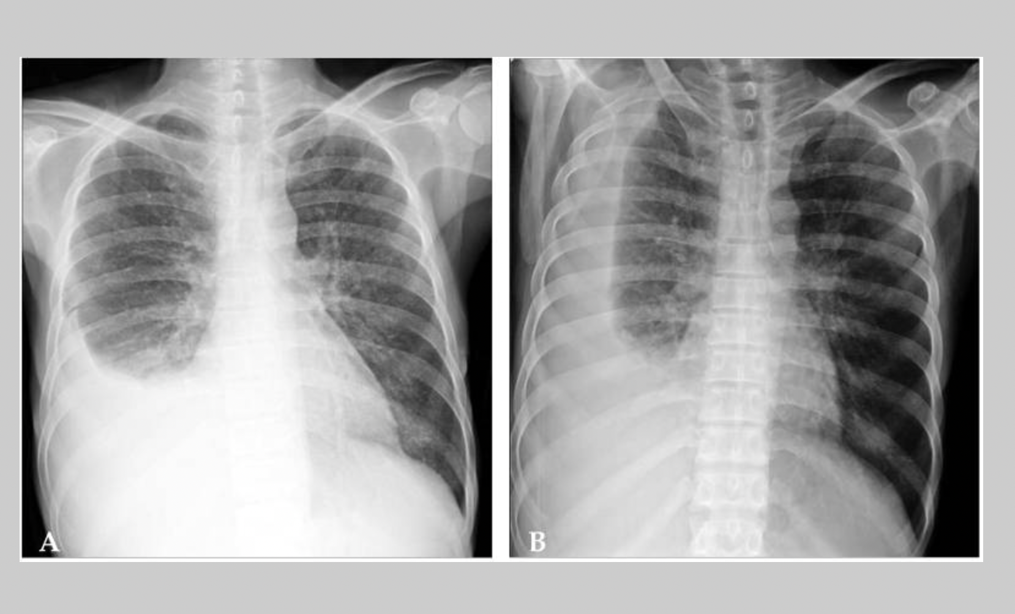
Radiology
A chest X ray report was suggestive of TB

Slide 8
Diagnosis
What is your diagnosis?
What other investigations will you order?

Slide 9
Further investigations
The patient's urine Histoplasma antigen test returned a level of >20 ng/ml
After 8 days, both his fungal blood culture and fungal bone marrow culture grew H. capsulatum.
Was treated with liposomal amphotericin B for 2 weeks,
followed by itraconazole indefinitely
Commenced ART concurrently and currently alive and in care

Slide 10
Case 2
42-year old man, known HIV patient returning to care after defaulting for 18months
Presented with symptoms of generalized weakness and fever
Generalized weakness, fever and cough developed 3 months prior to presentation
The patient had experienced a 12-kg weight loss
The CD4 cell count was 92/µL and the HIV RNA titer was 22,000 copies/mL.
Sputum Genexpert was positive

Slide 11
Treatment initiated
Anti-tuberculosis medications (isoniazid, rifampin, ethambutol, pyrazinamide) were started and continued for 40 days
Fluconazole and trimethoprim/sulfamethoxazole were given as prophylaxis because of the low CD4 cell count
Despite the treatment, his generalized weakness and fever continued
He was then subsequently admitted
Upon admission, his body temperature was 37.6℃, He had oral thrush and hepatosplenomegaly with ascites

Slide 12
Lab results at admission
hemoglobin 10.6g/dL
WBC 2,700/µL
platelet 58,000/µL
total bilirubin 2.4mg/dL
AST/ALT 131/48IU/L
ALP 114IU/L
GGT133 IU/L
AFB smear was negative

Slide 13
Deterioration persists
ARTs were started on admission day 1.
The severity of the pancytopenia progressed rapidly; the laboratory tests showed a hemoglobin of 7.4g/dL, a white blood cell count of 1,070/µL and a platelet count of 13,000/µL
Rifampin, zidovudine, and trimethoprim/sulfamethoxazole were discontinued due to possible bone marrow suppression associated with these medications
Pancytopenia persisted
On day 5; developed new pulmonary infiltrates and septic shock; empirical antibiotic therapy with piperacillin/tazobactam was started

Slide 14
On day 6, the patient was transferred to the intensive care unit for mechanical ventilator support
Gram stain and ordinary culture from sputum and blood revealed no pathologic organisms
Despite treatment, the pancytopenia, pneumonia, and hepatosplenomegaly did not improve
A bone marrow aspiration and biopsy were performed on day 9
However, the patient died on day 10 as a result of refractory septic shock and hypoxia
The results of the bone marrow aspiration smears and biopsy revealed numerous intra-cytoplasmic organisms identified as Histoplasma capsulatum
This patient was confirmed to have concomitant disseminated histoplasmosis

Slide 15
Case 3: History
A 17-year-old male with complaints of abdominal pain and swelling, and yellowness of the eye for one month.
Fever, cough productive of thick yellowish sputum and fast breathing of six days duration.
Child was a known TB patient on the 5th month of anti-TB therapy and was compliant. HIV status was NEGATIVE

Slide 16
Examination findings
Acute on chronically ill-looking, dyspnoeic, moderately pale, moderately icteric, febrile (38.6ºc), with generalized lymphadenopathy (axillary and cervical)
Grade 3 finger clubbing with widespread hypopigmented macular rashes, wasted, pitting pedal oedema, with oxygen saturation of 96-97% in room air.
Weight was 44kg (less than 3rd centile for age).

Slide 17
Examination findings
His respiratory rate was 43 cycles per minute with stony dull percussion notes in the right middle and lower lung zone and reduced air entry.
The abdomen was uniformly distended, with tenderness over the right hypochondrial region
hepatomegaly of 8cm below the right costal margin and ascites
His Pulse rate was 128 beats per minute, BP was 100/70 mm/Hg

Slide 18
Investigations
The working diagnosis - right lobar pneumonia with pleural effusion in a teen with pulmonary tuberculosis.
Oxygen was commenced at 2litres/ minute with intravenous ceftriaxone, azithromycin and Gentamicin.
PCV was 17% and he was transfused with whole blood
FBC showed leucocytosis of 21.67x10^{9/L}
Absolute neutrophilia with a differential count of 96%
lymphocytes of 2.4%
monocytes 1.4%
eosinophils 0.1% and basophils 0.1%
Platelet count 151 x10⁹/L with toxic granulations and hypersegmented neutrophils on the peripheral blood film.

Slide 19
Investigations
Abdominal USS revealed hepatosplenomegaly with ascites and grade 2 renal parenchymal disease
Ascitic fluid Xpert MTB/Rif assay for tuberculosis -NEGATIVE
LFTs
total bilirubin of 93.3 (2-17umol/l)
conjugated bilirubin, 86.3umol/l
AST 4IU/l
ALT 3IU/l
ALP 88IU/l

Slide 20
Investigations
Temperature had remained unstable with alternating febrile episodes and hypothermia.
E&U + Cr
Na134mmol/l
K⁺ 3.0mmol/l
chloride 100mmol/l
Urea 3.2mmol/l
Bicarbonate 18mmol/l
Creatinine 82.5umol/l.
Antibiotic was switched to Intravenous ciprofloxacin.
He improved after three days of intravenous ciprofloxacin with reduction in temperature instability and regression of pedal oedema

Slide 21
Investigations
However, PCV dropped to 18% and he received another unit of whole blood
Chest X ray on day 13 – findings consistent with pleural effusion
Chest tube was inserted - 750mls of purulent blood-stained
Mycobacterium tuberculosis was not detected
Blood film; suggestive of septicaemia with marked neutrophilia, lymphopenia, toxic granulations also seen with poikilocytosis and anisocytosis.

Slide 22
Investigations
Day 28 - Clinical microbiologist consult
Peripheral blood film showed numerous extracellular and intracellular yeast-like organisms, with eccentric chromatin in monocytes, features diagnostic of H. capsulatum
The child continued to show worsening of symptoms with continuous fever over ensuing days up to the 30th day of admission despite the initial improvement on intravenous ciprofloxacin.
Child died before anti-fungal medication could be commenced.

Slide 23
Histoplasmosis overview
MMSN

Slide 24
Histoplasmosis
Etiology: Histoplasma capsulatum
  Dimorphic
    Mold in nature and in culture at ≤30ºC
    Yeast in human body and in culture at 37ºC
    There are two varieties of the species, differing mainly in the yeast phase and having same mold phase. These varieties are:
      H.cap. var. capsulatum; Has small (2-3 x 3-4 μm) oval yeast cells. Causes the usual histoplasmosis.
      H.cap. var. duboisii; Has large yeast cells (7-15μm), causes African histoplasmosis.

Slide 25

Histoplasmosis
  The mold phase has white colonies, septate hyphae, produces two types of conidia; Tuberculated macroconidia (8-14μm), and smooth microconidia (2-5 μm).
Tuberculated macroconidium
Microconidium
H.cap.var.cap. Yeast phase
H.cap.var.dub. Yeast phase
Histoplasma capsulatum Mold phase
  The natural habitat of the fungus is specific soils rich bat guano and droppings of certain birds
  Because caves harbor bats – Thus called “Cave Disease”.

Slide 26
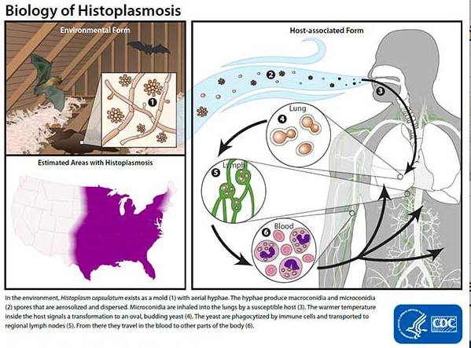
Pathogenesis

Slide 27
Pathogenesis
Inhaled spores produced by the mould form of H. capsulatum are deposited in the alveoli.
Morphogenesis at body temperature into the yeast forms and are ingested by pulmonary macrophages and neutrophils
The yeasts multiply within these cells and travel to hilar and mediastinal lymph nodes, where they gain access to the blood circulation through the lymphatics and eventually disseminate to various organs

Slide 28
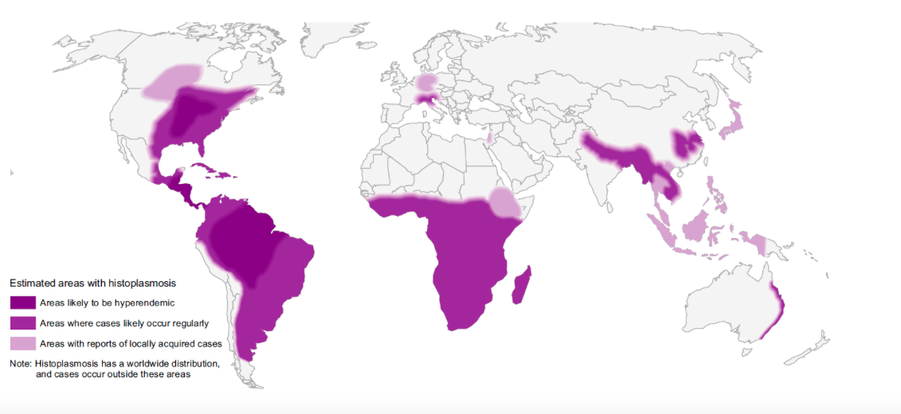
Distribution of histoplasmosis

Slide 29
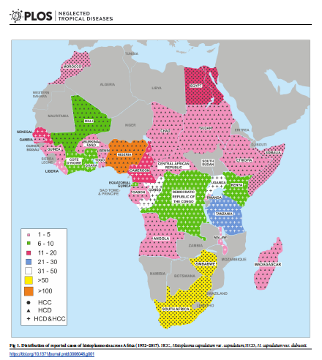
Distribution of reported cases of Histoplasmosis in Africa (1952 – 2017)

Slide 30
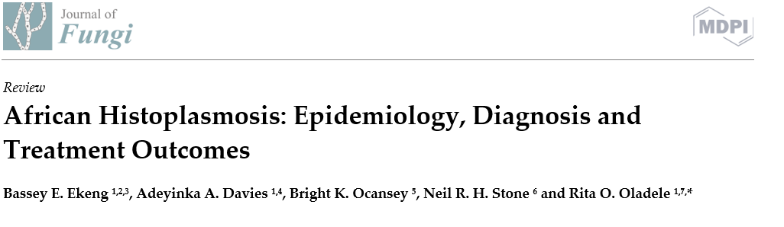
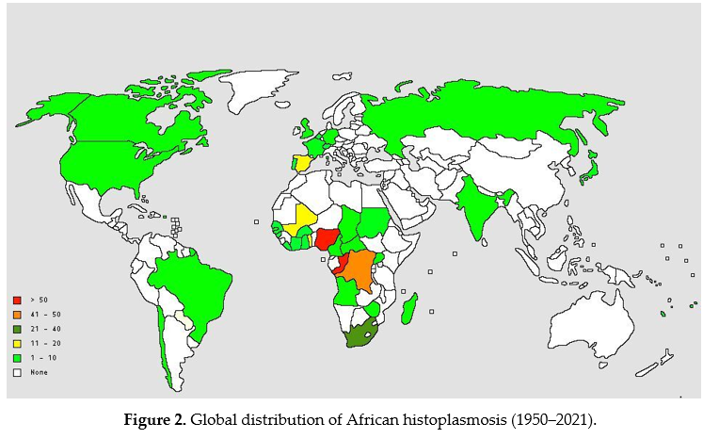

Slide 31
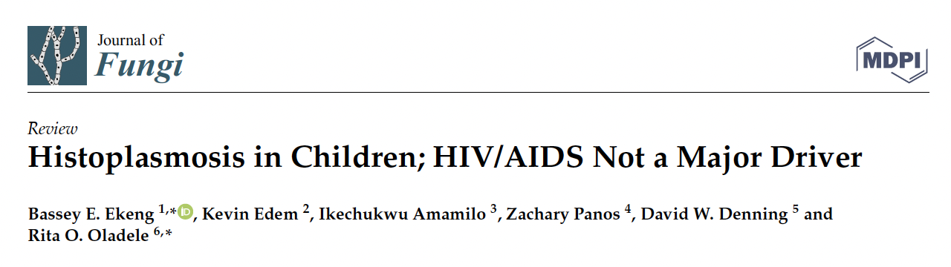
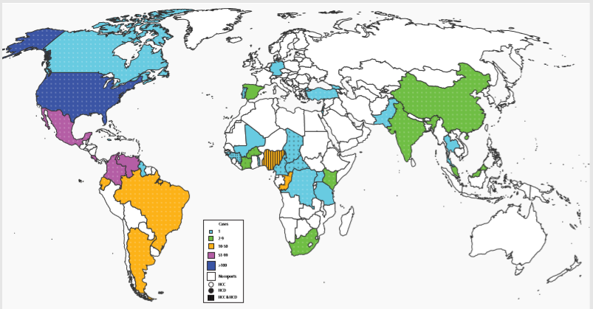

Slide 32
Histoplasmosis in Africa
Histoplasmin skin sensitivity rates of 0 -35%
Recent multicentre screening in Nigeria – 4.4% (Oladele et al 2018 PLOS)
Benin city highest rates despite no reported cases
20 countries in Africa – no data
Challenges:
Lack of awareness amongst clinicians
Lack of skilled personnel
Diagnostic facilities
Oladele et al 2018, PLOS NTD

Slide 33
Recently completed survey
No report of histoplasmosis amongst PLHIV in Nigeria since advent of HIV epidemic
Multicenter study – 10 sites
AHD population
Urinary antigen test
Sample per patient with one week interval
7.7%
PCR to confirm cases – more or less

Slide 34
Another just concluded study in Calabar, Nigeria
Presumptive TB population
213 patients
Confirmed TB-94; HIV Pos-75; AHD – 41; HIV Neg - 138
Urinary antigen and sputum PCR
Urinary antigen -23(10.7%)
18(8.45%) – sputum PCR positive
An over all prevalence of 12.7% by Histoplasma antigen test and/or PCR
Ekeng Bassey 2021

Slide 35
Neglected or an emerging disease?
Histoplasmosis is a neglected disease in Africa.
  because histoplasmosis in Africa has increased markedly , but is under-recognised.
  Histoplasmosis may be misdiagnosed as tuberculosis.
Africa has a significant number of people living with HIV/AIDS. – need a high index of suspicion
The ongoing health agenda for Africa has to acknowledge the lack of skilled personnel and facilities to make the diagnosis of histoplasmosis in Africa.
There is limited accessibility and availability of antifungal agents on the African continent.

Slide 36
Why Surveillance
Estimated high burden of TB in Nigeria
High mortality rates of histoplasmosis; 5–15% of AIDS-related deaths every year in this Region
High presentation of advanced HIV disease and challenge with defaulters
It is in our current AHD package of care guidelines
Prevent development of complications
Early diagnosis improves outcome

Slide 37
Recognizing signs and symptoms of histoplasmosis, diagnosis

Slide 38

Synopsis
Introduction
Pulmonary disease
Disseminated Disease
Cutaneous Disease
At risk population
Histoplasmosis and TB
Diagnosis

Slide 39
Clinical presentation
Immune status and underlying conditions in patients as well as inoculum size
Asymptomatic infections usually result from low level of exposure in healthy hosts, while the acute infections usually follow heavy inocula
Most cases of acute histoplasmosis in immunocompetent individuals tend to resolve spontaneously
Chronic pulmonary histoplasmosis is commonly seen in patients with underlying lung disease characterised by abnormal lung structure or lung damage. The disease is progressive and is not usually self-limiting

Slide 40
Clinical presentation
Disseminated infection may occur among immunocompromised individuals including those with AIDS, hematologic malignancies and organ transplantation
African histoplasmosis rarely manifests as pulmonary disease but more commonly as skin lesions (papules, nodules, ulcers, swellings, lymph node enlargement) and subcutaneous abscesses
Disseminated histoplasmosis results from the haematogenous spread of infection from the lungs.
Symptoms are non-specific and can mimic many other clinical conditions including malaria, tuberculosis, sepsis, hepatic failure, hematologic disorders and malignancies

Slide 41
HIV and Africa
In 2016, 36.7 million people were estimated to be living with HIV.
An estimated 25.5 million people in sub-Saharan Africa are living with HIV.
35 million people have been estimated to have died of AIDS related illnesses.
1.9 million Nigerians including adults and children are estimated to be living with HIV.
In 1987, Histoplasmosis was classified as an AIDS defining disease.
UNAIDS Data 2017

Slide 42
Other at risk Population
Children
Immunosuppressive states
Travel to endemic areas
Farming
Game reserves
Hunters
Cave explorers

Slide 43
Other at risk Population
Construction or demolition worker
Restorer of historic or abandoned buildings
Heating and air-conditioning system installer or service person
Pest control worker
Gardener
microbiology laboratory worker
Cave explorers

Slide 44
TB and Histoplasmosis
TB is the closest mimic of histoplasmosis, and limited access to diagnostic facilities may be responsible for some misdiagnoses
Similar to pulmonary TB, chronic pulmonary histoplasmosis starts with
malaise
Fever
Fatigue
Cough
Sputum
However, sputum production, weight loss, and night sweat are less prominent than TB

Slide 45
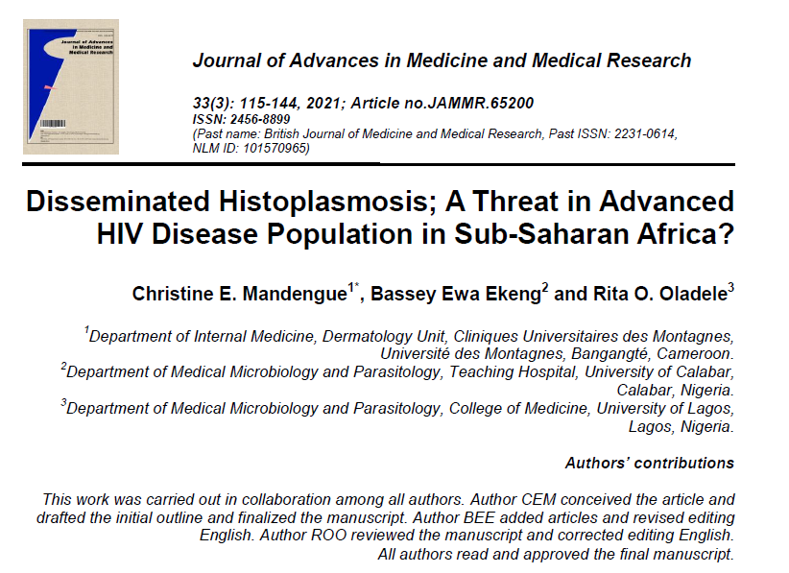
Histoplasmosis and TB
Nine case patients, initially diagnosed and unsuccessfully treated for TB, with disseminated histoplasmosis detected at a late stage.
Of the nine patients four died, two were diagnosed at postmortem, two recovered, the outcome was unknown in one of the case patients

Slide 46
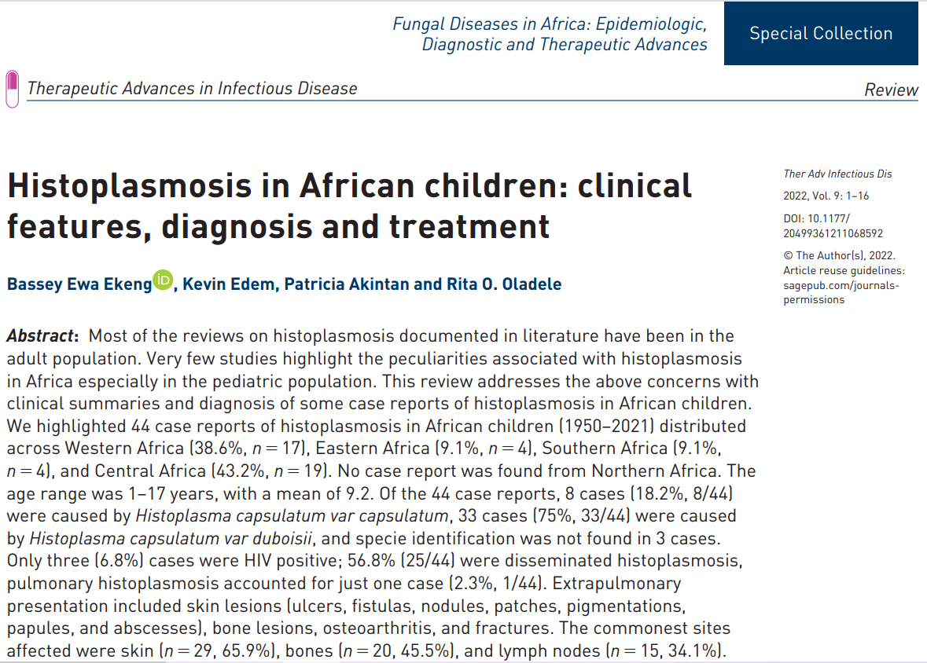
Histoplasmosis and TB
Histoplasmosis misdiagnosed as other conditions including tuberculosis (n=3, 6.8%), pneumonia (n=1, 2.3%), cancers (n=4, 9.1%), nephritic syndrome (n=1, 2.3%), leishmaniasis (n=1, 2.3%), and hyperreactive malarial splenomegaly syndrome (n=1, 2.3%).
In 6.8%(n=3) of the cases diagnosis of histoplasmosis was made at autopsy

Slide 47
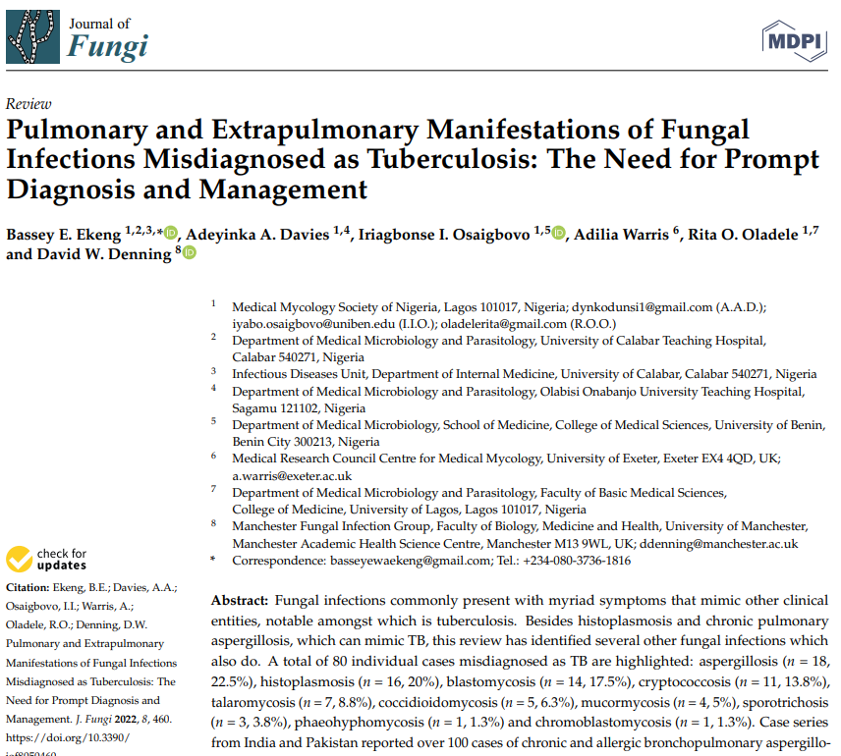
Histoplasmosis and TB
A total of 80 individual cases misdiagnosed as TB are highlighted:
Aspergillosis (n = 18, 22.5%)
Histoplasmosis (n = 16, 20%)
Blastomycosis (n = 14, 17.5%),
Cryptococcosis (n = 11, 13.8%)
Talaromycosis (n = 7, 8.8%)
Coccidioidomycosis (n = 5, 6.3%)
Mucormycosis (n = 4, 5%
Sporotrichosis (n = 3, 3.8%)
Phaeohyphomycosis (n = 1, 1.3%)
Chromoblastomycosis (n = 1, 1.3%).

Slide 48
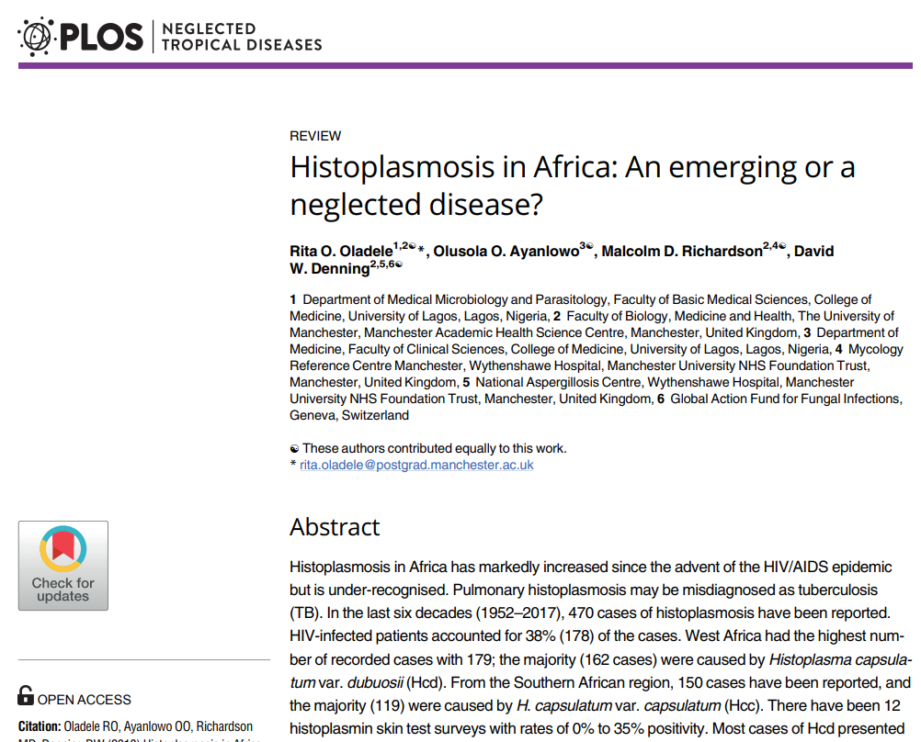
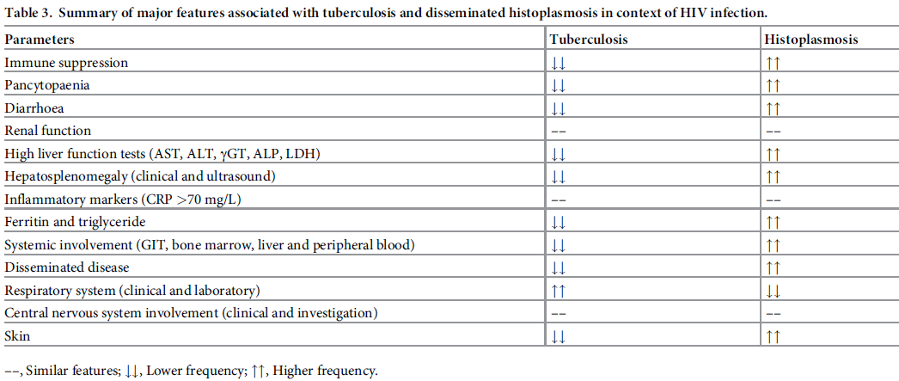
Summary of major features associated with tuberculosis and disseminated histoplasmosis in context of HIV infection

Slide 49
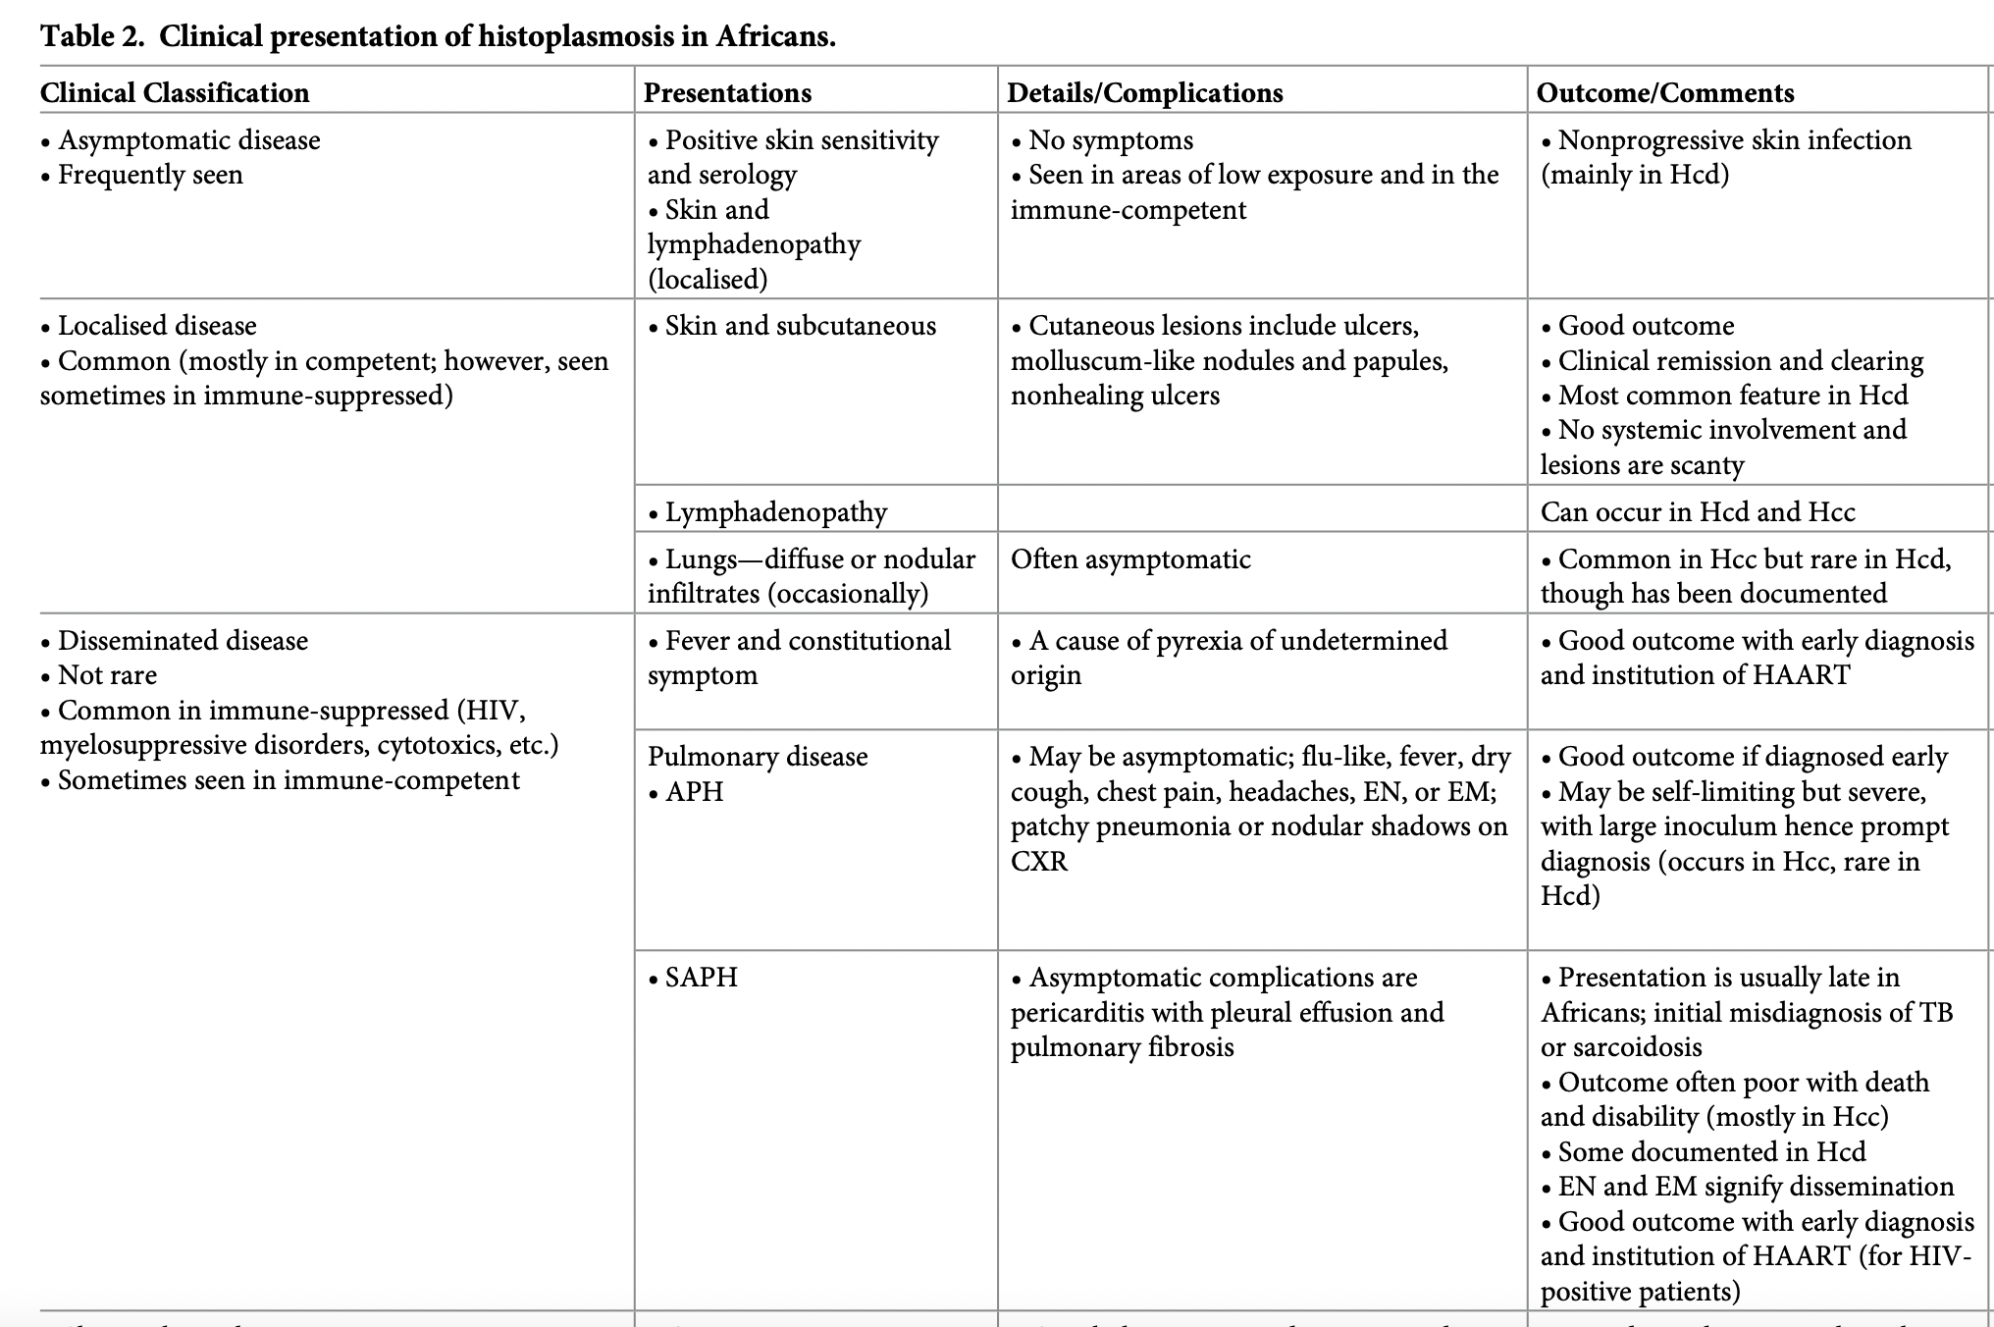

Slide 50
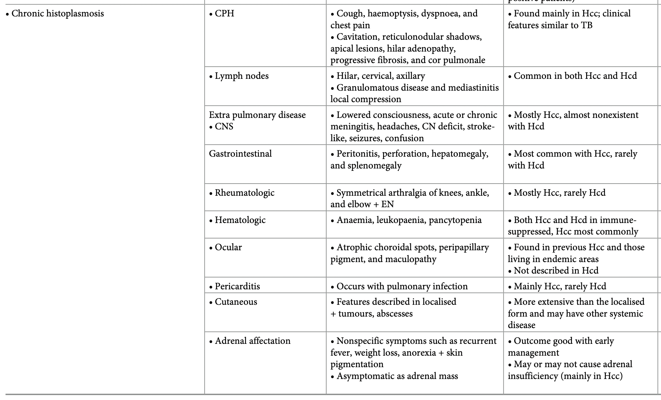

Slide 51
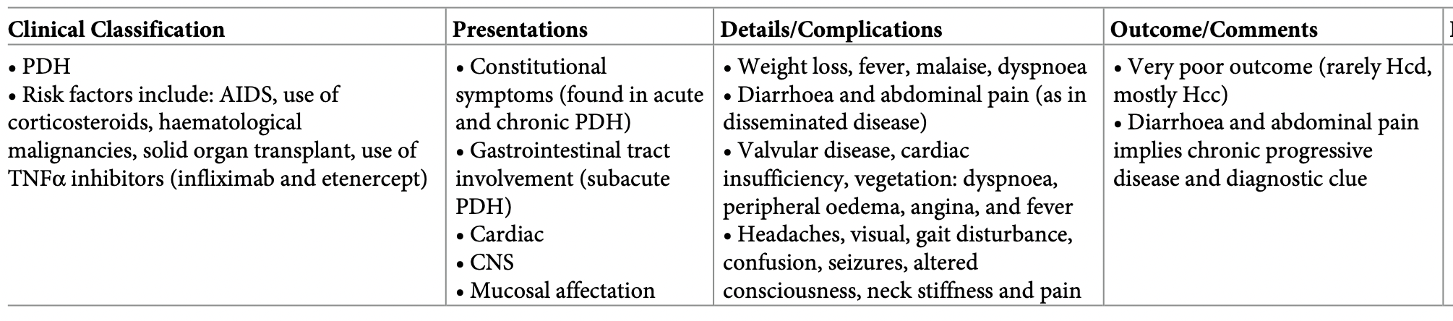

Slide 52
Diagnosis
Culture (gold standard) is potentially hazardous for laboratory personnel and requires a level 3 biosafety facility (not available in most African countries)
Microscopy (not so sensitive)
Histology (needs representative invasive sample)
The best approach in the diagnosis of disseminated histoplasmosis in HIV/AIDS is the detection of histoplasma antigen in urine, which is positive in over 70% of cases
This test is now a WHO recommended Essential Diagnostic

Slide 53
Diagnosis discussion
Meta-analysis - antigen detection tests have the highest analytical performance for diagnosing disseminated histoplasmosis among people living with HIV (overall sensitivity 95% and specificity 97%)
Culture-based assays presented variable analytical performance in diagnosing disseminated histoplasmosis (overall sensitivity of 77% and unknown specificity)
Antibody testing had high specificity but low sensitivity, probably because these people are highly immunosuppressed
Molecular testing through DNA detection - high diagnostic accuracy (sensitivity 95% and specificity 99%)
but the lack of consensus on techniques or procedures and the lack of availability of commercial kits makes implementing these types of assays difficult
WHO guidelines 2020

Slide 54
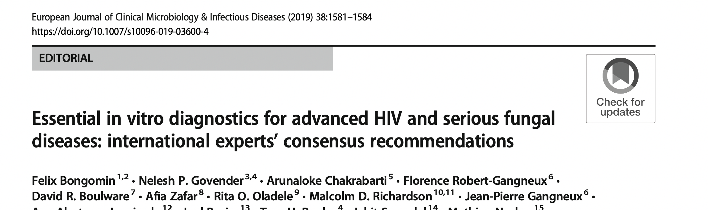
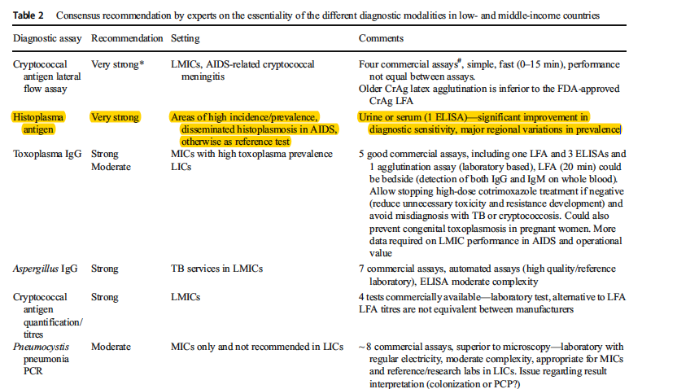

Slide 55
Treatment of histoplasmosis

Slide 56
Overview
Antifungal treatment is always recommended for immunocompromised patients with histoplasmosis
Acute histoplasmosis resolves without treatment in most immunocompetent healthy individuals, in whom treatment is usually not recommended
BUT if immunocompetent patients are exposure to large inoculum of Histoplasma spp. and are highly symptomatic, antifungal treatment is advised
Early initiation of treatment is associated with shortened duration of illness and halts progression to persistent disseminated histoplasmosis and save lives in very ill patients

Slide 57
Which manifestations to treat
USUALLY or ALWAYS treated
Usually NOT treated
Acute pulmonary histoplasmosis (sometimes)
Chronic pulmonary histoplasmosis (always)
Progressive (Acute) disseminated histoplasmosis (always)
Chronic disseminated (adrenal, colonic, oropharyngeal etc) (always)
Acute pulmonary histoplasmosis (usually)
Pulmonary nodules
Mediastinal histoplasmosis
  Lymphadenopathy
  Adenitis
  Fibrosis
Presumed ocular histoplasmosis
Wheat et al. Infect Dis Clin N Am. 2016;30:207-227

Slide 58
Acute pulmonary histoplasmosis
Treat
Don’t treat
Moderate-severe disease
Diffuse bilateral infiltrates on chest imaging
Immunosuppression
Treatment options:
Amphotericin B for 1-2 weeks followed by itraconazole for 12 weeks
Itraconazole alone for 12 weeks in mild to moderate disease
Asymptomatic patient
Mild disease
Focal infiltrates on chest imaging
Rationale:
  Mild acute pulmonary histoplasmosis is self-limiting

Slide 59
Pericarditis, Rheumatologic Syndromes
Chronic Cavitary Pulmonary Histoplasmosis
Nonsteroidal anti-inflammatory therapy is recommended in mild cases
Prednisone (0.5–1.0 mg/kg daily) in tapering doses over 1–2 weeks
Itraconazole (200 mg 3 times daily for 3 days and then once or twice daily for 6–12 weeks) is recommended if corticosteroids are administered
Itraconazole, 200 mg 3 times daily for 3 days and then once or twice daily for at least 1 year

Slide 60
Mediastinal Fibrosis
Mediastinal Lymphadenitis,
Mediastinal granuloma
Antifungal treatment is not recommended
The placement of intravascular stents is recommended for selected patients with pulmonary vessel obstruction
Broncholithiasis
Antifungal treatment is not recommended
Bronchoscopic or surgical removal of the broncholith
Treatment is usually unnecessary
Prednisone (0.5–1.0 mg/kg daily) in tapering doses over 1–2 weeks
Itraconazole (200 mg 3 times daily for 3 days and then once or twice daily for 6–12 weeks) is recommended if corticosteroids are administered

Slide 61
Disseminated Histoplasmosis
Mild-to-moderate disease
For moderately severe to severe disease
LAmB (3.0 mg/kg daily) for 1–2 weeks
Oral itraconazole (200 mg 3 times daily for 3 days and then 200 mg twice daily for a total of at least 12 months)
An alternative to LAmB is the deoxycholate formulation of amphotericin B (0.7–1.0 mg/kg daily)
Itraconazole (200 mg 3 times daily for 3 days and then twice daily for at least 12 months)
Lifelong suppressive therapy with itraconazole (200 mg daily) is required in patients who relapse despite receipt of appropriate therapy and immunosuppressed patients

Slide 62
Disseminated histoplasmosis classification definitions
Mild to moderate histoplasmosis
Severe or moderately severe histoplasmosis
Presence of at least one sign or symptom involving vital organs: respiratory or circulatory failure, neurological signs, renal failure, coagulation anomalies
Signs and symptoms that do not include the above features defining severe or moderately severe histoplasmosis

Slide 63
Histoplasmosis in pregnancy
CNS Histoplasmosis
LAmB (3.0–5.0 mg/kg daily for 4–6 weeks)
The deoxycholate formulation (0.7–1.0 mg/kg daily) is an alternative in patients who are at a low risk for nephrotoxicity
If the newborn shows evidence for infection, treatment is recommended with AmB deoxycholate (1.0 mg/kg daily for 4 weeks)
LAmB, 5.0 mg/kg daily, given over 4–6 weeks
Itraconazole (200 mg 2 or 3 times daily) for at least 1 year and until resolution of CSF abnormalities, including Histoplasma antigen levels

Slide 64
Prophylaxis for Immunosuppressed Patients
Prophylaxis with itraconazole (200 mg daily) is recommended in patients with HIV infection with CD4 cell counts < 150 cells/mm3
Prophylaxis with itraconazole (200 mg daily) may be appropriate in specific circumstances in other immunosuppressed patients

Slide 65
Histoplasmosis in children;
Acute Pulmonary Histoplasmosis
Treatment indications and regimens are similar to those for adults
AmB deoxycholate 1 mg/kg daily is usually well tolerated, and the lipid preparations are not preferred
Itraconazole dosage in children is 5.0–10.0 mg/kg daily in 2 divided doses (not to exceed 400 mg daily)

Slide 66
Histoplasmosis in children;
Disseminated Histoplasmosis
Amphotericin B deoxycholate (1.0 mg/kg daily for 4– 6 weeks)
Alternatively, AmB deoxycholate (1.0 mg/kg daily for 2– 4 weeks) followed by itraconazole (5.0–10.0 mg/kg daily in 2 divided doses) to complete 3 months of therapy can be given

Slide 67
Histoplasmosis in children;
Disseminated Histoplasmosis
Longer therapy may be needed for patients with severe disease, immunosuppression, or primary immunodeficiency syndromes
Lifelong suppressive therapy with itraconazole (5.0 mg/kg daily, up to 200 mg daily);
In immunosuppressed patients if immunosuppression cannot be reversed
In patients who experience relapse despite receipt of appropriate therapy

Slide 68
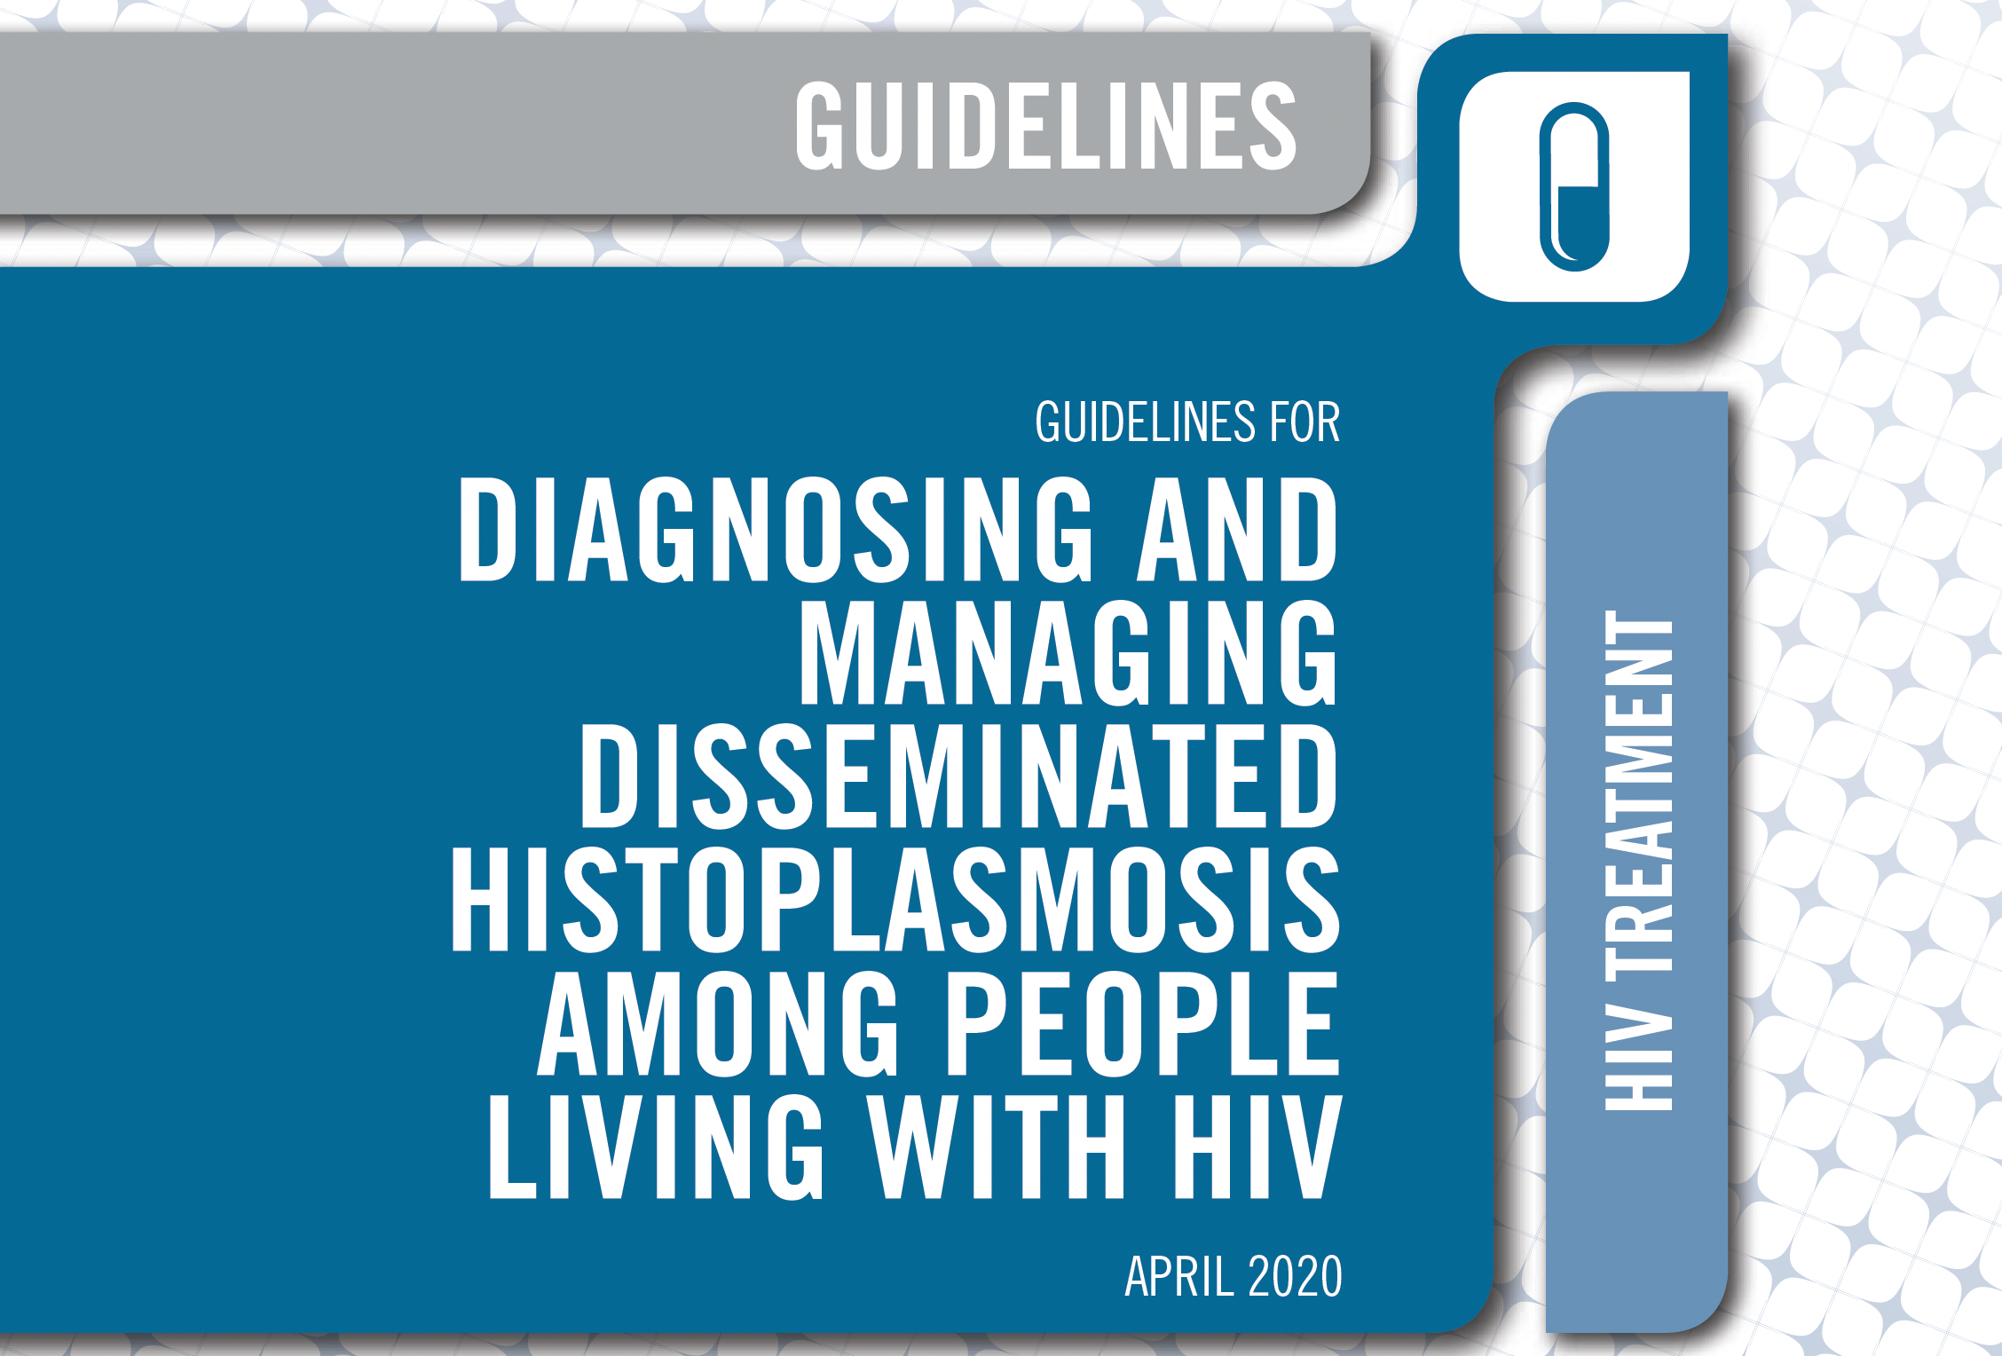

Slide 69
Induction
Maintanance
Treating severe or moderately severe;
liposomal amphotericin B, 3.0 mg/kg, for two weeks is recommended
Treating mild to moderate histoplasmosis
Itraconazole 200 mg three times daily for three days
Then 200 mg twice daily is recommended
Itraconazole 200 mg twice daily for 12 months is recommended
Less than 12 months of therapy can be considered;
when the person is clinically stable
receiving antiretroviral therapy
suppressed viral loads
immune status has improved

Slide 70
Timing of ART initiation
Antiretroviral therapy should be initiated as soon as possible among people with disseminated histoplasmosis for whom central nervous system involvement is not suspected or proven
Immune reconstitution inflammatory syndrome associated with histoplasmosis is unusual
People living with HIV with TB and histoplasmosis coinfection should receive TB therapy according to WHO treatment guidelines

Slide 71
Adjunct therapy
Short-course oral steroid therapy - life-threatening complications despite appropriate treatment of histoplasmosis
1–2 mg/kg per day of prednisone or the equivalent be given for 1–2 weeks
Dose-tapering for two weeks

Slide 72
Monitoring the toxicity of amphotericin B treatment
Drug toxicity and side-effects from amphotericin B therapy and drug–drug interactions associated with itraconazole use are important barriers to the successful treatment
Renal function should be evaluated to prevent, monitor, and manage toxicity such as
Nephrotoxicity
Hypokalemia
infusion-related reactions
Anemia
Measure renal function regularly

Slide 73
Barriers to successful treatment
Itraconazole blood levels, should be monitored after two weeks of therapy
Blood levels of itraconazole between 1 and 2 μg/mL have been recognized as effective.
Concentrations higher than 15 μg/mL has been related with development of toxic
Lack of capacity for drug monitoring should not be an obstacle to itraconazole treatment
The co-occurrence of other opportunistic infections should be evaluated

Slide 74
Barriers to successful treatment
When histoplasmosis is not controlled because of interactions with rifampicin and itraconazole, clinicians should consider the following;
Extending the duration of amphotericin B induction therapy (once-weekly courses of amphotericin B)
Increasing the itraconazole dose and monitoring the blood level and toxicity
Considering using other azole drugs (posaconazole, voriconazole, or fluconazole)
Consider replacing rifampicin with rifabutin

Slide 75
Monitoring the treatment response
Clinical response; including resolution of fever, fatigue, and weight changes and other symptoms associated with disease severity (hypotension and hypoxia) should be assessed daily during the initial period of induction therapy
Monitor progress by using Histoplasma antigen testing following treatment initiation

Slide 76
Persistent or recurrent symptoms
Review patient adherence
Investigate for presence of co-infection e.g TB in patients with CD4 cells counts <200 cells/mm³
Consider paradoxical immune reconstitution inflammatory syndrome among people who have started ART
Ensure appropriate drug levels, as necessary

Slide 77
Managing relapse
In case of persistent or recurrent symptoms related to disseminated histoplasmosis, induction therapy should be restarted
It is important to ensure adherence to therapy and appropriate dose, drug levels, and duration
Measure Histoplasma urinary antigen
Prevent, manage, and monitor for drug toxicity
Ensure appropriate drug levels, as necessary

Slide 78
Chronic disseminated histoplasmosis
Benefits of antifungal treatment
Treatment options
Resolution of gastrointestinal lesions
Possibility of adrenal dysfunction recovery
Probably improved survival in those with adrenal masses and dysfunction
Avoidance of later complications (i.e. gut stricture or dissemination if immunocompromised)
Itraconazole 200-400mg daily for 6-12 months, unless already given empirical rifampicin for adrenal tuberculosis
Amphotericin B (preferably liposomal), if pretreated with rifampicin or other major drug interaction
Precautions
Pro-actively address adrenal dysfunction to avoid cortisol deficiency and ‘Addisonian crisis’
Ensure itraconazole levels are therapeutic

Slide 79
Summary
Itraconazole is the first line of therapy for the treatment of mild to moderate histoplasmosis
Liposomal amphotericin B is recommended for initial management of hospitalised patients and AHD patients with disseminated disease and is associated with improved outcome
Be alert to and check for adrenal insufficiency, especially if rifampicin has been given
Treatment of disseminated disease should continue for at least 12 months and until antigenaemia and antigenuria have resolved
Alternative triazoles (voriconazole, posaconazole and isavuconazole) can be used for salvage therapy

Slide 80
Thanks for Listening

Slide 81
Questions/ Comments!!

