Slide 1

Treatment of histoplasmosis

Slide 2
Objectives
Understand the treatment goals for histoplasmosis
Managing disseminated histoplasmosis in AHD
Be aware of treatment outcomes in histoplasmosis

Slide 3
Overview
Antifungal treatment is always recommended for immunocompromised patients with histoplasmosis
Acute histoplasmosis resolves without treatment in most immunocompetent healthy individuals, in whom treatment is usually not recommended
BUT if immunocompetent patients are exposed to large inoculum of Histoplasma spp. and are highly symptomatic, antifungal treatment is advised
Early initiation of treatment is associated with shortened duration of illness and halts progression to persistent disseminated histoplasmosis and save lives in very ill patients

Slide 4
Which manifestations to treat
USUALLY or ALWAYS treated
Usually NOT treated
Acute pulmonary histoplasmosis (sometimes)
Chronic pulmonary histoplasmosis (always)
Progressive (Acute) disseminated histoplasmosis (always)
Chronic disseminated (adrenal, colonic, oropharyngeal etc) (always)
Acute pulmonary histoplasmosis (usually)
Pulmonary nodules
Mediastinal histoplasmosis
  Lymphadenopathy
  Adenitis
  Fibrosis
Presumed ocular histoplasmosis
Wheat et al. Infect Dis Clin N Am. 2016;30:207-227

Slide 5
Acute pulmonary histoplasmosis
Treat
Don’t treat
Moderate-severe disease
Diffuse bilateral infiltrates on chest imaging
Immunosuppression
Treatment options:
Amphotericin B for 1-2 weeks followed by itraconazole for 12 weeks
Itraconazole alone for 12 weeks in mild to moderate disease
Asymptomatic patient
Mild disease
Focal infiltrates on chest imaging
Rationale:
  Mild acute pulmonary histoplasmosis is self-limiting

Slide 6
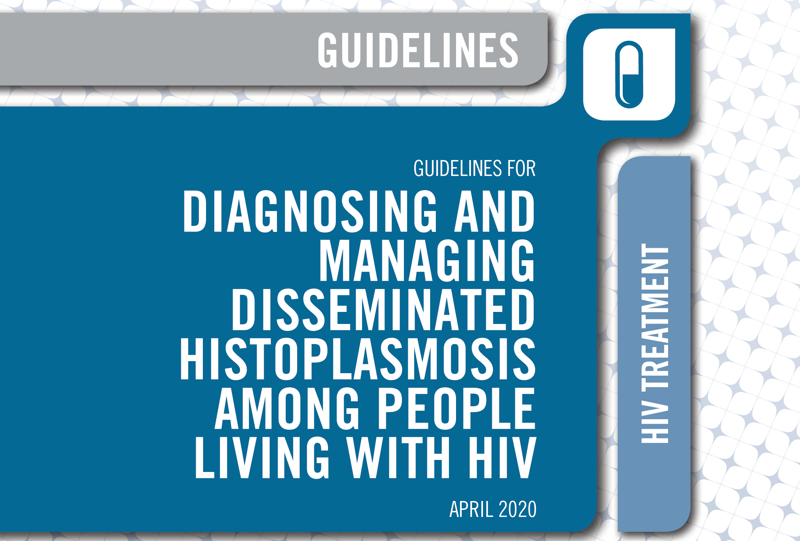

Slide 7
Induction
Maintanance
Treating severe or moderately severe;
liposomal amphotericin B, 3.0 mg/kg, for two weeks is recommended
Treating mild to moderate histoplasmosis
Itraconazole 200 mg three times daily for three days
Then 200 mg twice daily is recommended
Itraconazole 200 mg twice daily for 12 months is recommended
Less than 12 months of therapy can be considered;
when the person is clinically stable
receiving antiretroviral therapy
suppressed viral loads
immune status has improved

Slide 8
Timing of ART initiation
Antiretroviral therapy should be initiated as soon as possible among people with disseminated histoplasmosis for whom central nervous system involvement is not suspected or proven
Immune reconstitution inflammatory syndrome associated with histoplasmosis is unusual
People living with HIV with TB and histoplasmosis coinfection should receive TB therapy according to WHO treatment guidelines

Slide 9
Adjunct therapy
Short-course oral steroid therapy - life-threatening complications despite appropriate treatment of histoplasmosis
1–2 mg/kg per day of prednisone or the equivalent be given for 1–2 weeks
Dose-tapering for two weeks

Slide 10
Monitoring the toxicity of amphotericin B treatment
Drug toxicity and side-effects from amphotericin B therapy and drug–drug interactions associated with itraconazole use are important barriers to the successful treatment
Renal function should be evaluated to prevent, monitor, and manage toxicity such as
Nephrotoxicity
Hypokalemia
infusion-related reactions
Anemia
Measure renal function regularly

Slide 11
Monitoring the treatment response
Clinical response, including resolution of fever, fatigue, and weight changes and other symptoms associated with disease severity (hypotension and hypoxia) should be assessed daily during the initial period of induction therapy
Itraconazole blood levels, should be monitored after two weeks of therapy
Blood levels of itraconazole between 1 and 2 μg/mL have been recognized as effective.
Concentrations higher than 15 μg/mL has been related with development of toxic
Lack of capacity for drug monitoring should not be an obstacle to itraconazole treatment
The co-occurrence of other opportunistic infections should be evaluated

Slide 12
Persistent or recurrent symptoms
Review patient adherence
Investigate for presence of co-infection e.g TB in patients with CD4 cells counts <200 cells/mm³
Consider paradoxical immune reconstitution inflammatory syndrome among people who have started ART
Monitor progress by using Histoplasma antigen testing following treatment initiation
Ensure appropriate drug levels, as necessary

Slide 13
Managing relapse
In case of persistent or recurrent symptoms related to disseminated histoplasmosis, induction therapy should be restarted
It is important to ensure adherence to therapy and appropriate dose, drug levels, and duration
Measure Histoplasma urinary antigen
Prevent, manage, and monitor for drug toxicity
Ensure appropriate drug levels, as necessary

Slide 14
Chronic disseminated histoplasmosis
Benefits of antifungal treatment
Treatment options
Resolution of gastrointestinal lesions
Possibility of adrenal dysfunction recovery
Probably improved survival in those with adrenal masses and dysfunction
Avoidance of later complications (i.e. gut stricture or dissemination if immunocompromised)
Itraconazole 200-400mg daily for 6-12 months, unless already given empirical rifampicin for adrenal tuberculosis
Amphotericin B (preferably liposomal), if pretreated with rifampicin or other major drug interaction
Precautions
Pro-actively address adrenal dysfunction to avoid cortisol deficiency and ‘Addisonian crisis’
Ensure itraconazole levels are therapeutic

Slide 15
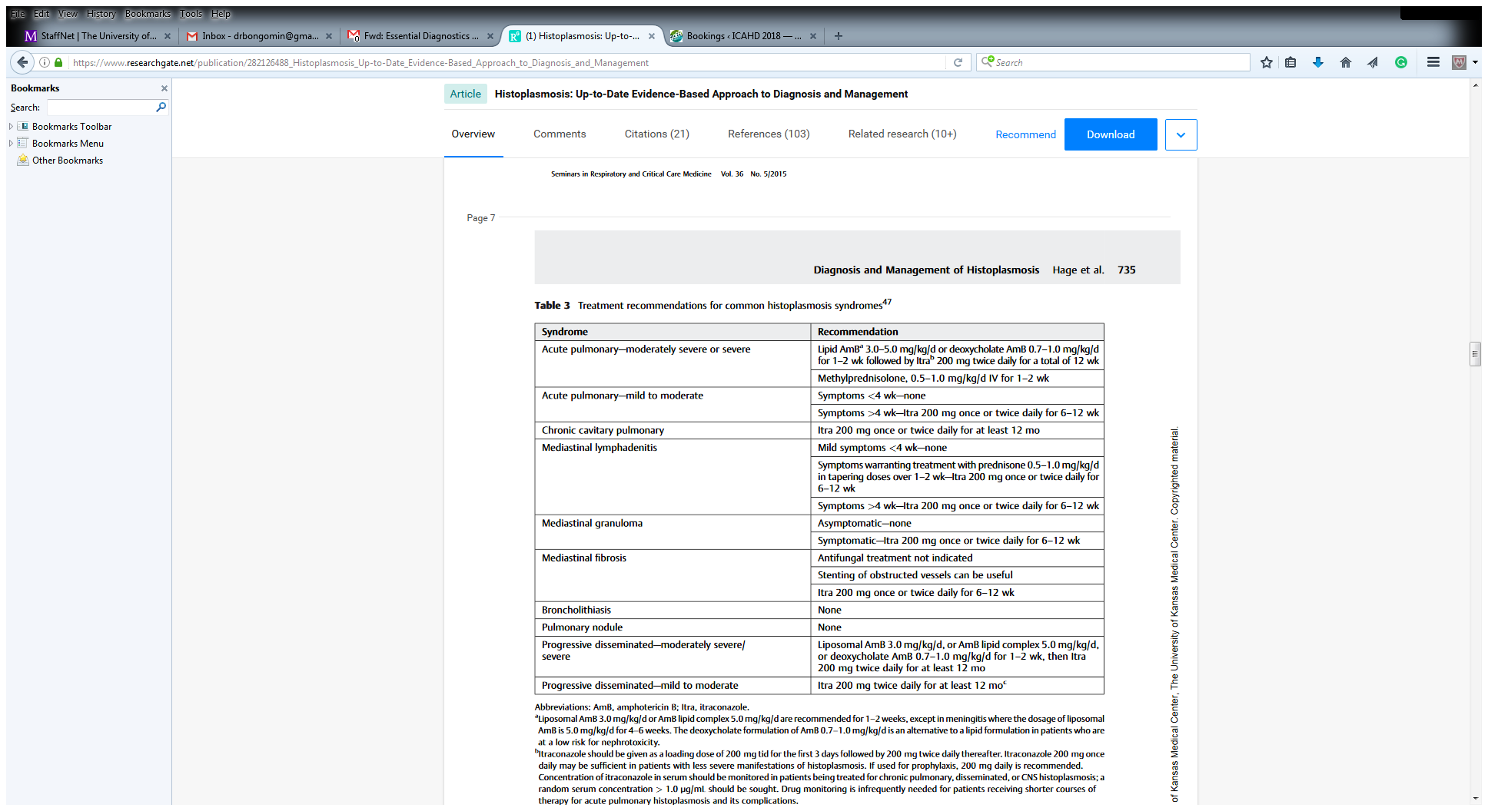
Treatment for common histoplasmosis syndromes
Adapted from Hage et al. Semin Respir Crit Care Med. 2015;36:729–745

Slide 16
Outcomes
Response to therapy
  60-80%
  Relapse occur in ~50% of responders
Life-long therapy is recommended for patients with relapse
Mortality
  100% if untreated
  CNS disease, ~80% (<5% with early diagnosis and early appropriate treatment)
  HIV and disseminated, ~20-40%
  Other manifestations, 0-10%
Wheat et al Infect Dis Clin N Am. 2016;30:207-227
Haynes et al J Infect Dis. 2002;185:223-8

Slide 17
Summary
Itraconazole is the first line of therapy for the treatment of mild to moderate histoplasmosis
Liposomal amphotericin B is recommended for initial management of hospitalised patients and AHD patients with disseminated disease and is associated with improved outcome
Be alert to and check for adrenal insufficiency, especially if rifampicin has been given
Treatment of disseminated disease should continue for at least 12 months and until antigenaemia and antigenuria have resolved
Alternative triazoles (voriconazole, posaconazole and isavuconazole) can be used for salvage therapy

Slide 18
Thanks for Listening

