Slide 1
Histoplasmosis overview
MMSN

Slide 2
Histoplasmosis
This is an intracellular infection of the reticuloendothelial system (RES).
  Starts as respiratory- could be self-limiting.
  The pulmonary form similar to tuberculosis – there is caseation and fibrosis
  Disseminates to RES (liver, spleen, bone marrow …. Macrophages).
Etiology: Histoplasma capsulatum
  Dimorphic, imperfect, moniliaceous fungus.
    Mold in nature and in culture at ≤30ºC
    Yeast in human body and in culture at 37ºC
    There are two varieties of the species, differing mainly in the yeast phase and having same mold phase. These varieties are:
      H.cap. var. capsulatum; Has small (2-3 x 3-4 μm) oval yeast cells. Causes the usual histoplasmosis.
      H.cap. var. duboisii; Has large yeast cells (7-15μm), causes African histoplasmosis.

Slide 3
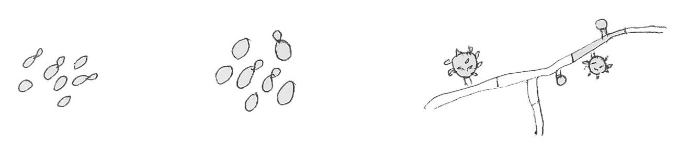
Histoplasmosis
  The mold phase has white colonies, septate hyphae, produces two types of conidia; Tuberculated macroconidia (8-14μm), and smooth microconidia (2-5 μm).
Tuberculated macroconidium
Microconidium
H.cap.var.cap. Yeast phase
H.cap.var.dub. Yeast phase
Histoplasma capsulatum Mold phase
  The natural habitat of the fungus is specific soils rich bat guano and droppings of certain birds
  Because caves harbor bats – Thus called “Cave Disease”.

Slide 4
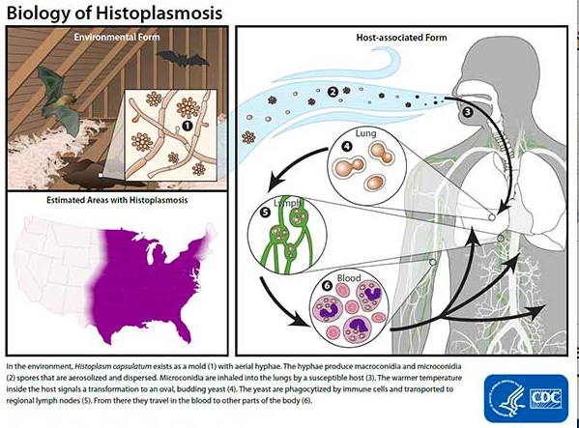
Pathogenesis

Slide 5
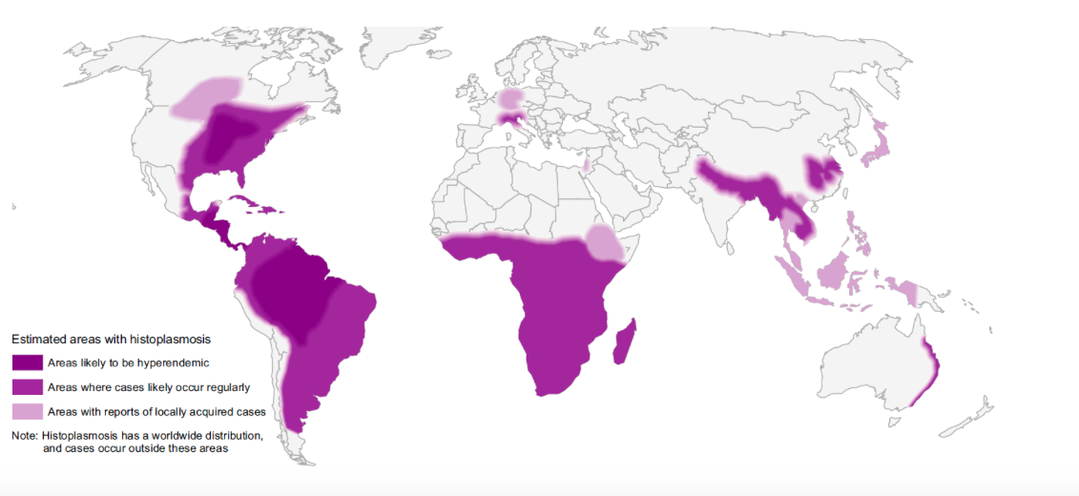
Distribution of histoplasmosis

Slide 6
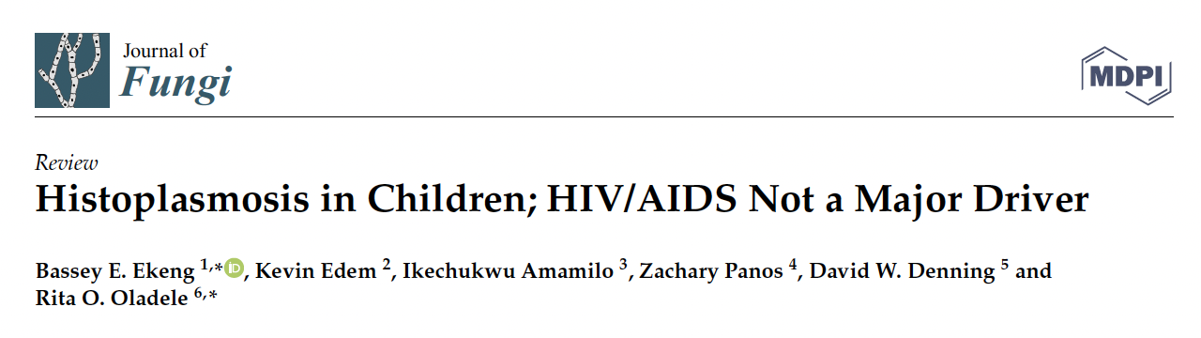
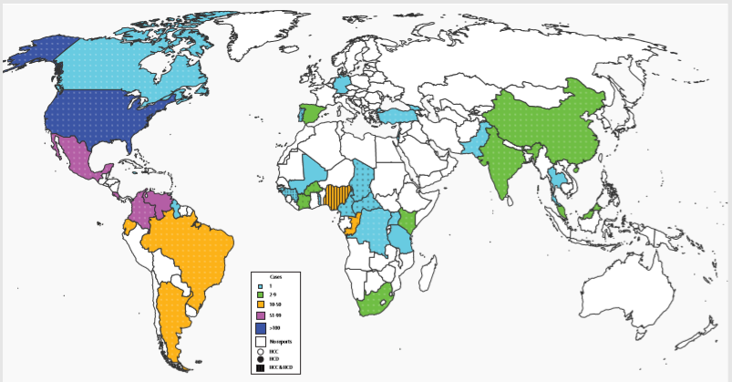

Slide 7
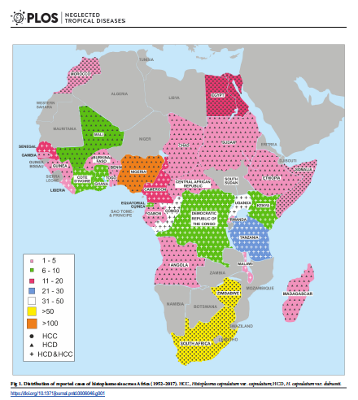
Distribution of reported cases of Histoplasmosis in Africa (1952 – 2017)

Slide 8
Mortality rates
Histoplasmosis is one of the most frequent opportunistic infections caused by fungal pathogens among people living with HIV in the Americas
5–15% of AIDS-related deaths every year in this Region
Annually; 15,600 new cases and 4,500 deaths among people living with HIV
WHO GUIDELINES 2020

Slide 9
Histoplasmosis in Africa
Histoplasmin skin sensitivity rates of 0 -35%
Recent multicentre screening in Nigeria – 4.4% (Oladele et al 2018 PLOS)
Benin city highest rates despite no reported cases
20 countries in Africa – no data
Challenges:
Lack of awareness amongst clinicians
Lack of skilled personnel
Diagnostic facilities
Oladele et al 2018, PLOS NTD

Slide 10
Histoplasmosis and TB
In 2020, there were an estimated 1.28 million TB deaths among HIV-negative people and an additional 214,000 deaths among HIV-positive people (up from 209,000 in 2019) . (WHO, 2021. Global TB report)
How many were smear negative TB?
Histoplasmosis is commonly misdiagnosed as TB(Wheat LJ 2006 Mycoses)
Africa has a significant number of people living with HIV/AIDS which is the greatest attributable risk factor for DH

Slide 11
Neglected or an emerging disease?
Histoplasmosis is a neglected disease in Africa.
  because histoplasmosis in Africa has increased markedly but is under-recognized.
  Histoplasmosis may be misdiagnosed as tuberculosis.
Africa has a significant number of people living with HIV/AIDS. – need a high index of suspicion
The ongoing health agenda for Africa has to acknowledge the lack of skilled personnel and facilities to make the diagnosis of histoplasmosis in Africa.
There is limited accessibility and availability of antifungal agents on the African continent.

Slide 12
Recently completed survey
42% AHD
No report of histoplasmosis amongst PLHIV in Nigeria since advent of HIV epidemic
Multicenter study – 10 sites
AHD population
Urinary antigen test
Sample per patient with one week interval
6.7%
PCR to confirm cases – more or less

Slide 13
Another just concluded study in Calabar, Nigeria
Presumptive TB population
213 patients
TB-94; HIV -75; co-infection HIV/TB-, 34; and previously treated TB patients -13
Urinary antigen and sputum PCR
Urinary antigen -23(10.7%)
18(8.45%) – sputum PCR positive
2(11.11%)- HIV and TB co-infection, 11(61.11%) were negative for both TB and HIV, 5 (27.78%) were infected by TB, 4(22.22%) were infected by HIV, 2(11.11%) were previously treated for TB, none were MDR TB patients
Ekeng Bassey 2021

Slide 14
Why screening
Estimated high burden of TB in Nigeria
High mortality rates of histoplasmosis
High presentation of advanced HIV disease and challenge with defaulters
It is in our current AHD package of care guidelines
Prevent development of adrenal histoplasmosis
Early diagnosis improves outcome
Advocacy for integration with routine ART and TB care

Slide 15
