Slide 1

Recognizing signs and symptoms of histoplasmosis, diagnosis

Slide 2

Synopsis
Introduction
At risk population
Pulmonary disease
Disseminated Disease
Cutaneous Disease
Diagnosis

Slide 3
HIV and Africa
In 2016, 36.7 million people were estimated to be living with HIV.
An estimated 25.5 million people in sub-Saharan Africa are living with HIV.
35 million people have been estimated to have died of AIDS related illnesses.
3.2 million Nigerians including adults and children are estimated to be living with HIV.
In 1987, Histoplasmosis was classified as an AIDS defining disease.
UNAIDS Data 2017

Slide 4
Clinical presentation
Immune status and underlying conditions in patients as well as inoculum size
Asymptomatic infections usually result from low level of exposure in healthy hosts, while the acute infections usually follow heavy inocula
Most cases of acute histoplasmosis in immunocompetent individuals tend to resolve spontaneously
Chronic pulmonary histoplasmosis is commonly seen in patients with underlying lung disease characterised by abnormal lung structure or lung damage. The disease is progressive and is not usually self-limiting

Slide 5
Clinical presentation
Disseminated infection may occur among immunocompromised individuals including those with AIDS, hematologic malignancies and organ transplantation
African histoplasmosis rarely manifests as pulmonary disease but more commonly as skin lesions (papules, nodules, ulcers, swellings, lymph node enlargement) and subcutaneous abscesses
Disseminated histoplasmosis results from the haematogenous spread of infection from the lungs.
Symptoms are non-specific and can mimic many other clinical conditions including malaria, tuberculosis, sepsis, hepatic failure, hematologic disorders and malignancies

Slide 6
TB and Histoplasmosis
TB is the closest mimic of histoplasmosis, and limited access to diagnostic facilities may be responsible for some misdiagnoses
Similar to pulmonary TB, chronic pulmonary histoplasmosis starts with
malaise
Fever
Fatigue
Cough
Sputum
However, sputum production, weight loss, and night sweat are less prominent than TB

Slide 7
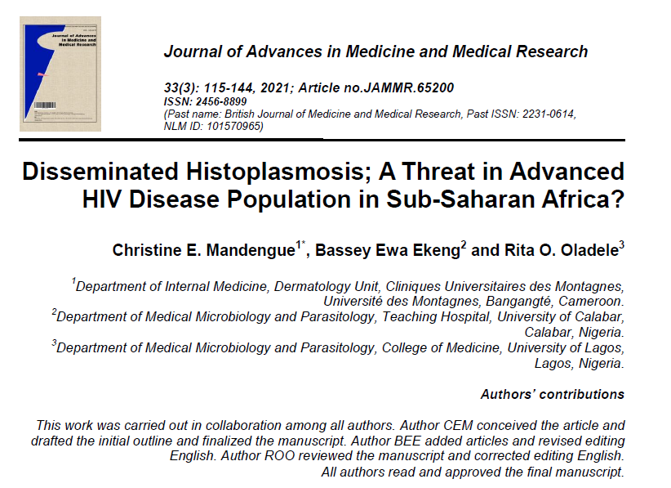
Histoplasmosis and TB
Nine case patients, initially diagnosed and unsuccessfully treated for TB, with disseminated histoplasmosis detected at a late stage. Of the nine patients four died, two were diagnosed at postmortem, two recovered, the outcome was unknown in one of the case patients

Slide 8
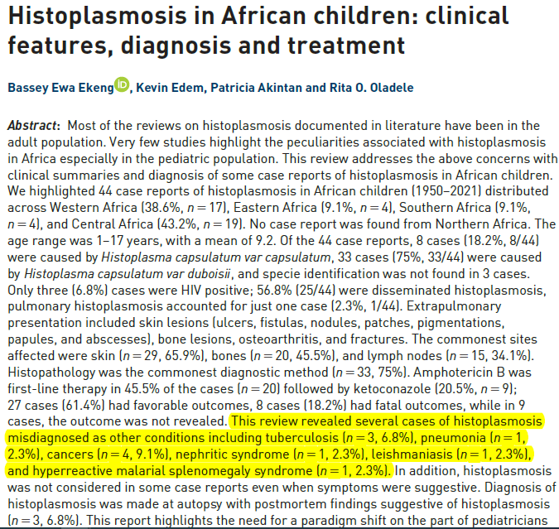
Histoplasmosis and TB

Slide 9
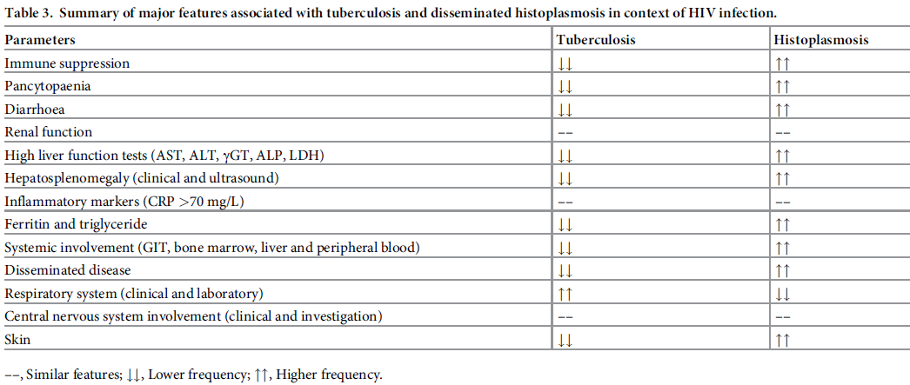
Summary of major features associated with tuberculosis and disseminated histoplasmosis in context of HIV infection

Slide 10
Other at risk Population
Children
Immunosuppressive states
Travel to endemic areas
Farming
Game reserves
Hunters
Cave explorers

Slide 11
Other at risk Population
Construction or demolition worker
Restorer of historic or abandoned buildings
Heating and air-conditioning system installer or service person
Pest control worker
Gardener
microbiology laboratory worker
Cave explorers

Slide 12
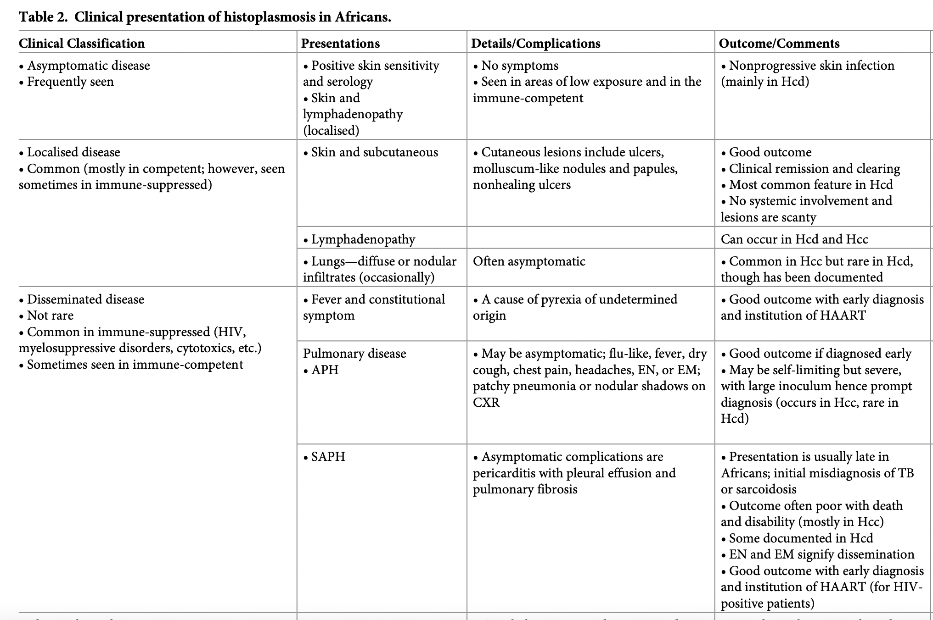

Slide 13
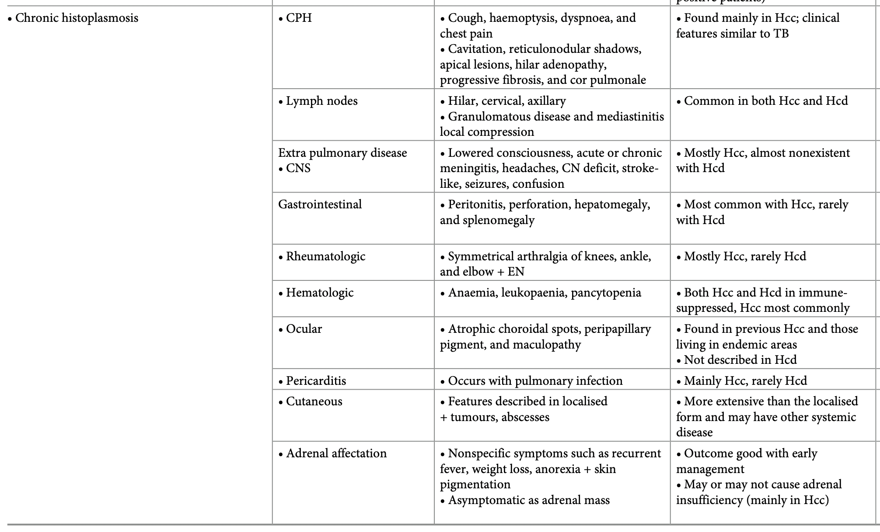

Slide 14
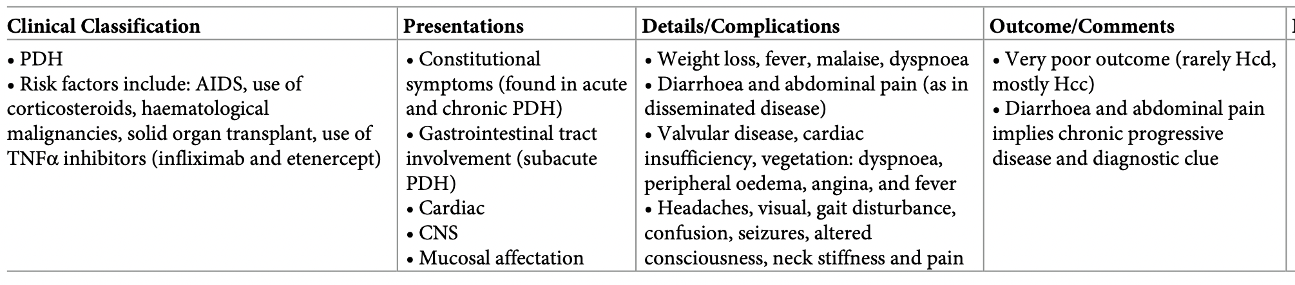

Slide 15
Diagnosis
Culture (gold standard) is potentially hazardous for laboratory personnel and requires a level 3 biosafety facility (not available in most African countries)
Microscopy (not so sensitive)
Histology (needs representative invasive sample)
The best approach in the diagnosis of disseminated histoplasmosis in HIV/AIDS is the detection of histoplasma antigen in urine, which is positive in over 70% of cases
This test is now a WHO recommended Essential Diagnostic

Slide 16
Diagnosis discussion
Meta-analysis - antigen detection tests have the highest analytical performance for diagnosing disseminated histoplasmosis among people living with HIV (overall sensitivity 95% and specificity 97%)
Culture-based assays presented variable analytical performance in diagnosing disseminated histoplasmosis (overall sensitivity of 77% and unknown specificity)
Antibody testing had high specificity but low sensitivity, probably because these people are highly immunosuppressed
Molecular testing through DNA detection - high diagnostic accuracy (sensitivity 95% and specificity 99%)
but the lack of consensus on techniques or procedures and the lack of availability of commercial kits makes implementing these types of assays difficult
WHO guidelines 2020

Slide 17
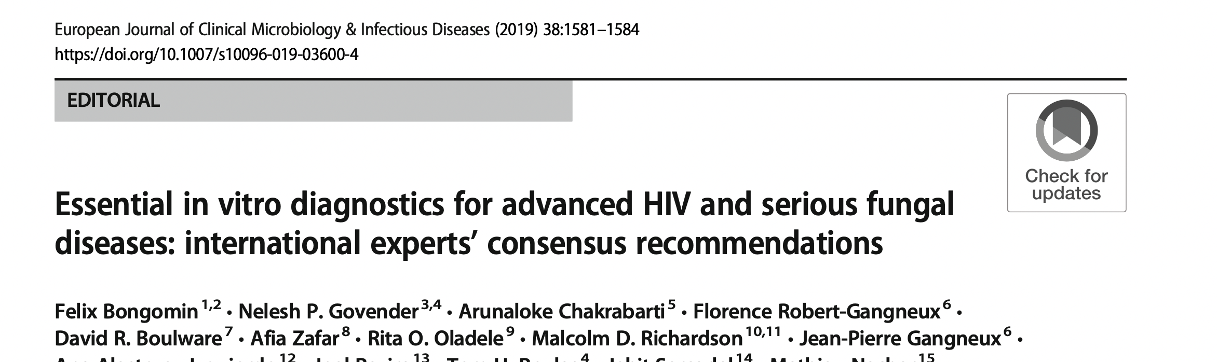
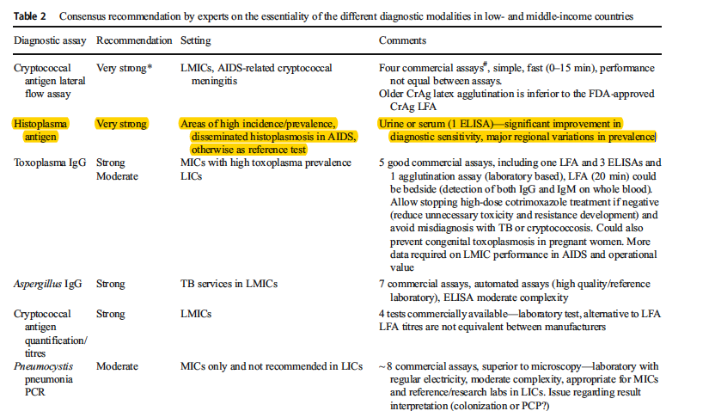

Slide 18
Questions/ Comments!!

