Slide 1

Case reports

Slide 2
Case 1
A 69-year-old female working at construction sites (carrying loads)
She also works in farms
Presented with 2 months of shortness of breath, dry cough, subjective fevers, and an unintentional 8kg weight loss
Review of symptoms was also notable for constant, diffuse headaches and nausea without vomiting or abdominal pain
Multiple sexual partners in the past, but presently monogamous

Slide 3
Case 1: clinicals
On physical examination;
Afebrile and saturating 100% on room air
Frail and appeared chronically ill
Lungs were clear upon auscultation bilaterally

Slide 4
Preliminary lab results
Pancytopenia, with a WBC of 3.82 × 10⁹/liter (4.22 × 10⁹ to 10.33 × 10⁹/liter)
hemoglobin of 8.1 g/dl (13.2 to 16.9 g/dl),
platelet count of 31 × 10⁹/liter (160 × 10⁹ to 383 × 10⁹/liter),
hyponatremia, with a sodium conc of 124 mmol/liter (135 to 145 mmol/liter)
elevated ferritin level of 57,180 ng/dl (30 to 400 ng/ml)

Slide 5
More lab results
Retroviral screening - HIV type 1 (HIV-1) and HIV-2 antibodies and p24 antigen was positive
CD4 count of 29 cells/μl (365 to 1,437 cells/μl)
HIV load of 720,440 copies/ml.
TB-LAM - negative

Slide 6
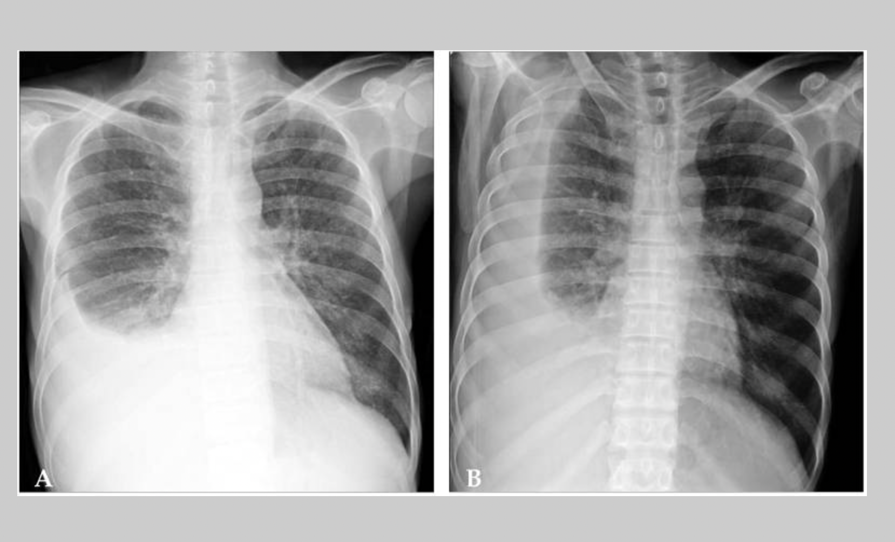
Radiology
A chest X ray report was suggestive of TB

Slide 7
Diagnosis
What is your diagnosis?
What other investigations will you order?

Slide 8
Further investigations
The patient's urine Histoplasma antigen test returned a level of >20 ng/ml
After 8 days, both his fungal blood culture and fungal bone marrow culture grew H. capsulatum.
Was treated with liposomal amphotericin B for 2 weeks,
followed by itraconazole indefinitely
Commenced ART concurrently and currently alive and in care

Slide 9
Case 2
42-year old man, known HIV patient returning to care after defaulting for 18months
Presented with symptoms of generalized weakness and fever
Generalized weakness, fever and cough developed 3 months prior to presentation
The patient had experienced a 12-kg weight loss
The CD4 cell count was 92/µL and the HIV RNA titer was 22,000 copies/mL.
Sputum Genexpert was positive

Slide 10
Treatment initiated
Anti-tuberculosis medications (isoniazid, rifampin, ethambutol, pyrazinamide) were started and continued for 40 days
Fluconazole and trimethoprim/sulfamethoxazole were given as prophylaxis because of the low CD4 cell count
Despite the treatment, his generalized weakness and fever continued
He was then subsequently admitted
Upon admission, his body temperature was 37.6℃, He had oral thrush and hepatosplenomegaly with ascites

Slide 11
Lab results at admission
hemoglobin 10.6g/dL
WBC 2,700/µL
platelet 58,000/µL
total bilirubin 2.4mg/dL
AST/ALT 131/48IU/L
ALP 114IU/L
GGT133 IU/L
AFB smear was negative

Slide 12
Deterioration persists
ARTs were started on admission day 1.
The severity of the pancytopenia progressed rapidly; the laboratory tests showed a hemoglobin of 7.4g/dL, a white blood cell count of 1,070/µL and a platelet count of 13,000/µL
Rifampin, zidovudine, and trimethoprim/sulfamethoxazole were discontinued due to possible bone marrow suppression associated with these medications
Pancytopenia persisted
On day 5; developed new pulmonary infiltrates and septic shock; empirical antibiotic therapy with piperacillin/tazobactam was started

Slide 13
On day 6, the patient was transferred to the intensive care unit for mechanical ventilator support
Gram stain and ordinary culture from sputum and blood revealed no pathologic organisms
Despite treatment, the pancytopenia, pneumonia, and hepatosplenomegaly did not improve
A bone marrow aspiration and biopsy were performed on day 9
However, the patient died on day 10 as a result of refractory septic shock and hypoxia
The results of the bone marrow aspiration smears and biopsy revealed numerous intra-cytoplasmic organisms identified as Histoplasma capsulatum
This patient was confirmed to have concomitant disseminated histoplasmosis

Slide 14
Case 3: History
A 17-year-old male with complaints of abdominal pain and swelling, and yellowness of the eye for one month.
Fever, cough productive of thick yellowish sputum and fast breathing of six days duration.
Child was a known TB patient on the 5th month of anti-TB therapy and was compliant. HIV status was NEGATIVE

Slide 15
Examination findings
Acute on chronically ill-looking, dyspnoeic, moderately pale, moderately icteric, febrile (38.6ºc), with generalized lymphadenopathy (axillary and cervical)
Grade 3 finger clubbing with widespread hypopigmented macular rashes, wasted, pitting pedal oedema, with oxygen saturation of 96-97% in room air.
Weight was 44kg (less than 3rd centile for age).

Slide 16
Examination findings
His respiratory rate was 43 cycles per minute with stony dull percussion notes in the right middle and lower lung zone and reduced air entry.
The abdomen was uniformly distended, with tenderness over the right hypochondrial region
hepatomegaly of 8cm below the right costal margin and ascites
His Pulse rate was 128 beats per minute, BP was 100/70 mm/Hg

Slide 17
Investigations
The working diagnosis - right lobar pneumonia with pleural effusion in a teen with pulmonary tuberculosis.
Oxygen was commenced at 2litres/ minute with intravenous ceftriaxone, azithromycin and Gentamicin.
PCV was 17% and he was transfused with whole blood
FBC showed leucocytosis of 21.67x10^{9/L}
Absolute neutrophilia with a differential count of 96%
lymphocytes of 2.4%
monocytes 1.4%
eosinophils 0.1% and basophils 0.1%
Platelet count 151 x10⁹/L with toxic granulations and hypersegmented neutrophils on the peripheral blood film.

Slide 18
Investigations
Abdominal USS revealed hepatosplenomegaly with ascites and grade 2 renal parenchymal disease
Ascitic fluid Xpert MTB/Rif assay for tuberculosis -NEGATIVE
LFTs
total bilirubin of 93.3 (2-17umol/l)
conjugated bilirubin, 86.3umol/l
AST 4IU/l
ALT 3IU/l
ALP 88IU/l

Slide 19
Investigations
Temperature had remained unstable with alternating febrile episodes and hypothermia.
E&U + Cr
Na134mmol/l
K⁺ 3.0mmol/l
chloride 100mmol/l
Urea 3.2mmol/l
Bicarbonate 18mmol/l
Creatinine 82.5umol/l.
Antibiotic was switched to Intravenous ciprofloxacin.
He improved after three days of intravenous ciprofloxacin with reduction in temperature instability and regression of pedal oedema

Slide 20
Investigations
However, PCV dropped to 18% and he received another unit of whole blood
Chest X ray on day 13 – findings consistent with pleural effusion
Chest tube was inserted - 750mls of purulent blood-stained
Mycobacterium tuberculosis was not detected
Blood film; suggestive of septicaemia with marked neutrophilia, lymphopenia, toxic granulations also seen with poikilocytosis and anisocytosis.

Slide 21
Investigations
Day 28 - Clinical microbiologist consult
Peripheral blood film showed numerous extracellular and intracellular yeast-like organisms, with eccentric chromatin in monocytes, features diagnostic of H. capsulatum
The child continued to show worsening of symptoms with continuous fever over ensuing days up to the 30th day of admission despite the initial improvement on intravenous ciprofloxacin.
Child died before anti-fungal medication could be commenced.

