Slide 1
Basics of Advanced HIV Disease
Notes:
INTRODUCE the module.
EXPLAIN that many individuals living with HIV/AIDS acquire diseases that also affect otherwise healthy individuals. However, HIV-infected patients may have a more severe disease course or may develop symptoms that uninfected individuals do not.
Opportunistic infections (OIs) are disease conditions which occur in an immuno-compromised individual. The effects of these infections account for most of the ill health associated with HIV/AIDS.
EXPLAIN that the complications can be general or divided into disease syndromes in the various systems such as Gastrointestinal System, Respiratory System, Central Nervous System, Dermatological System (skin), Head and Neck, Cardiovascular System, and Genitourinary, or Renal, System.
EXPLAIN that the following sessions will discuss OIs by body system or areas of the body that are affected. The first system to be discussed is the Gastrointestinal System.
EXPLAIN that it is not possible to discuss all opportunistic infections but more common ones will be discussed. The Participant Handbook contains much more detail about managing OIs than discussed in these sessions.
TELL participants that this module will take about 5 hours and 15 minutes. EXPLAIN that there will be breaks throughout this module.

Slide 2
Learning Objectives
By the end of this session, participants will be able to:
  Understand the background, burden and causes of Advanced HIV Disease (AHD)
  Know the components of the recommended WHO basic package of care for Advanced HIV Disease (AHD)
  Identify AHD patient with danger signs
  Understand the hub & spoke AHD model of care as a recommended approach to implementation of AHD care in resource limited settings
  Appreciate the need for appropriate laboratory services to support AHD package of care

Slide 3
ART has scaled up dramatically since 2000, reaching over 21M people living with HIV (PLHIV) in 2018
Historical scale up of PLHIV on ART in low- and middle-income countries (LMICs)
Number of AIDS-related deaths, global, 1990–2017 and 2020 target
Number of PLHIV on ART (millions)
Source: WHO/UNAIDS for historical estimates
Note: 2010-2018 ART coverage figures calculated for LMICs using 2019 World Bank Income Classifications and UNAIDS AIDSinfo database, accessed August 29, 2019 (only includes countries with both ART and PLHIV numbers reported)

Slide 4
Nigeria ART coverage and AIDS-related deaths
Historical scale up of PLHIV on ART in Nigeria
Estimated AIDS-related deaths in Nigeria
Number of PLHIV on ART (millions)
Source: NASCP

Slide 5





AIDS-related mortality is due to a number of factors
Why has progress in reducing mortality stalled?
    Delayed HIV diagnosis
    Delayed enrollment in care and ART initiation
    Patient abandoning care and loss-to-follow up
    Treatment failure due to non-adherence and drug resistance
Non-availability of diagnostics and treatment for some opportunistic infections
→ All contribute to HIV disease progression and AHD

Slide 6

Clinically, AHD is characterized by weakened immune systems
Basic Pathogenesis of HIV Infection
HIV infection is characterized by depletion of the CD4+ lymphocyte, the primary coordinator of the immune system
While the body can replace destroyed CD4+ cells, over time this ability is progressively degraded, leading to:
  Decreased numbers of circulating CD4+ cells
  Decreased immune function
  Increased susceptibility to infections
    Starting with more frequent common infections and
    Ultimately with unusual infections that a healthy immune system would be able to control (opportunistic infections)
While this progressive immune damage usually causes symptoms, often these symptoms go unnoticed and occasionally patients may have no symptoms at all

Slide 7
AIDS-related mortality is driven by a small number of OIs, including TB and fungal infections like Cryptococcus
Source: WHO AHD Guidelines, 2017.

Slide 8
WHO definition of AHD
For adults and adolescents, and children older than five years, AHD is defined as CD4+ lymphocyte count <200cells/mm³ or WHO stage 3 or 4 event
All children younger than five years old with HIV are considered as having AHD
In spite of increasing access to treatment, the number of people with advanced HIV at the time of diagnosis remains high and is not declining very fast, especially among men
The mortality rate among people with advanced HIV disease is high even with access to ART. The risk of death is higher with CD4+ lymphocyte count <100 cells/mm³

Slide 9
Approach to Management of Patients with AHD
Patient identified with new stage 3 or 4 disease or CD4+ lymphocyte count < 200
The approach to the management of patients with AHD is contingent on their clinical stability (e.g. ‘Ambulatory’ or ‘Critically unwell’) and their ART status
Screen for danger signs (Respiratory rate >30, Heart rate >120, Systolic BP <90mmHg, Temperature >39°C, moderate/severe dehydration, Unable to walk unaided, 0₂ saturation <90%, altered mental state/GCS <9, other neurological problems)
ABSENT
PRESENT
Complete clinical history and assessment for TB and other Ois
Conduct appropriate labs: CD4, TB LAM, Serum CrAg etc.
Patients with danger signs - admit or refer as appropriate
Provide urgent labs and supportive management (e.g. oxygen, IV fluids)
Start urgent treatment: (e.g. antibiotics, TB treatment, etc.).
Further management is based on two key criteria: Is the patient ART-naïve or Treatment experienced client returning to care

Slide 10
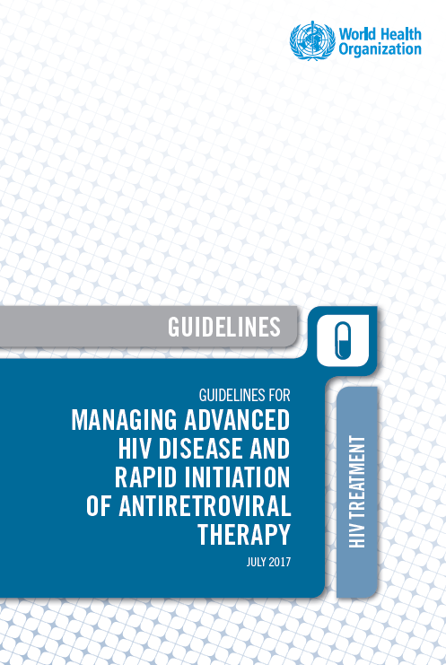
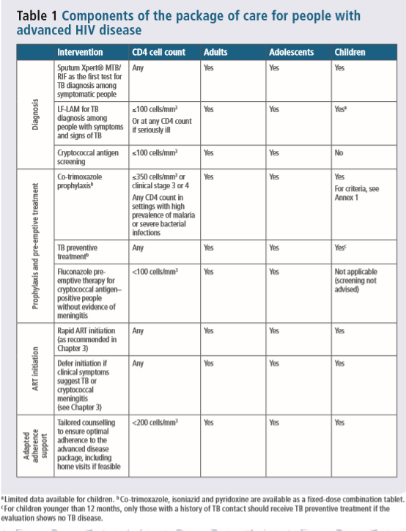
Summary of WHO Package of care for AHD
WHO, 2017
*Tailored counselling: considerations to be made e.g. for involvement of family support, community and/or home based care

Slide 11
Summary of package care for AHD – Nigeria
 | Intervention | CD4+ lymphocyte count
Diagnosis | XPERT MTB/RIF as first test for TB diagnosis | Any
 | TB-LAM LFA for TB diagnosis among people with signs and symptoms | <200 cell/mm³
 | Cryptococcal antigen screening | <200 cell/mm³
 | Screening for other OIs - PCP, Histoplasmosis, Toxoplasmosis, Severe bacterial infection, | <200 cell/mm³
Prophylaxis & pre-emptive therapy | Cotrimoxazole prophylaxis* | Any
 | TB preventive treatment* | Any
 | Fluconazole pre-emptive therapy for CrAg positive patients with no symptoms of meningitis | <200 cell/mm³
ART initiation | Rapid ART initiation | Any
 | Defer if clinical symptoms suggest TB or cryptococcal meningitis | Any
Adapted adherence support | Tailored intensive counselling to support adherence** | <200 cell/mm³
* For patients requiring CPT and TPT, the FDC of INH/CTX / Vit B6 can be used
**Tailored counselling: considerations to be made e.g. for involvement of family support, community and/or home based care
WHO, 2017

Slide 12





Factors affecting access to the AHD package of care
    Urgency of the diagnosis: If the patient is seriously unwell
    Complexity and availability of the tests that need to be performed
    The availability and frequency of sample transport and result delivery mechanisms
    Ability of the site to ensure quality control
    The knowledge and capacity of different levels of HR to urgently manage complex cases e.g. cryptococcal meningitis
    In-country policies for who can perform specific tests/procedures e.g. LP and prescribe certain medications
Notes:
Clarify the central message of this slide

Slide 13
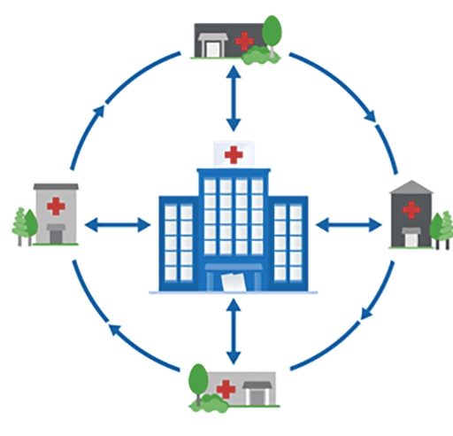
The “Hub & Spoke” model for access to AHD package of care
A hub and spoke system:
Spoke
Involves setting up local networks based on expertise and infrastructure of health facilities identified for AHD care (e.g. Cryptococcal Meningitis care in hub hospitals)
Hub
Provides reliable linkage to appropriate AHD services, including timely referral where need be e.g. Referral from spokes to Hubs for relevant care and support
Spoke
Spoke
Streamlines and permits easier coordination and communication by implementing partners and national programs to monitor uptake of AHD services, and to ensure quality
Spoke

Slide 14
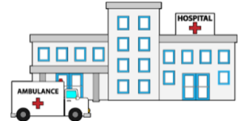
AHD care for patients with Danger signs/ hospitalized patients (Hub)
Hubs:
Definition: Hospital level facilities where comprehensive packages of AHD care can be implemented with;
  Clinical expertise in management of AHD patients with danger signs
  Appropriate storage facilities
  Laboratory capacity (timely and reliable laboratory monitoring e.g. renal function monitoring; basic microbiology including CSF culture)
Will serve as referral sites for spokes and will manage patients in need of hospitalization and regular monitoring e.g. in treatment of cryptococcal meningitis

Slide 15

AHD package for hospitalized patients (Hub)
Diagnosis
Prophylaxis & pre-emptive therapy
Treatment
Adapted adherence support
CD4+ lymphocyte count
CrAg – blood /CSF
TB LAM, Xpert
LP
Haematology &
chemistry
TPT
Fluconazole
CPT
Clinical Expertise
CCM Treatment
TB treatment
Other OI treatment*
Appropriate ART timing
Intensive adherence Counselling
Community-based support
PCP, Histoplasmosis, Severe Bacterial Sepsis, Toxoplasmosis

Slide 16

Spokes - provide AHD care package for ambulatory patients
Spokes:
Definition: Include primary health care facilities and hospitals with;
  limited clinical expertise and diagnostic capacity for AHD care.
  limited to no storage capacity (including cold chain) for AHD commodities
The spokes will;
  Offer outpatient and routine care to stable AHD patients.
  Refer AHD patients with danger signs in need of in-patient care to hubs within their proximity

Slide 17

AHD Package for outpatients (Spoke)
Should every CrAg positive be referred?
Yes
Diagnosis
CD4+ lymphocyte count
Prophylaxis & pre-emptive therapy
TPT
Treatment
Adapted adherence support
CrAg – blood
TB LAM, Access to Xpert*
Fluconazole
CPT
Intensive adherence counselling
Community - based support
TB treatment*
Continuation of Crypto care (Consolidation, Maintenance phases)
*Those accredited to provide TB diagnostic and treatment services

Slide 18

Key points
AIDS related deaths not decreasing commensurately with increased ART coverage
AHD is a major cause of death among PLHIV; the commonest cause of mortality in AHD patients include Tuberculosis and Cryptococcal meningitis
AHD is defined as CD4<200cell/mm³ and/or WHO clinical stage 3 or 4 event or CHLIV <5years old
Interventions required for AHD include diagnosis, treatment and prophylaxis for OIs, Rapid ART initiation and intensified adherence support

Slide 19
THANK YOU

