Slide 1
Interactions Between Antifungals & ARVs
Medical Mycology Society of Nigeria

Slide 2
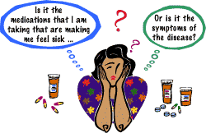
Introduction

Slide 3
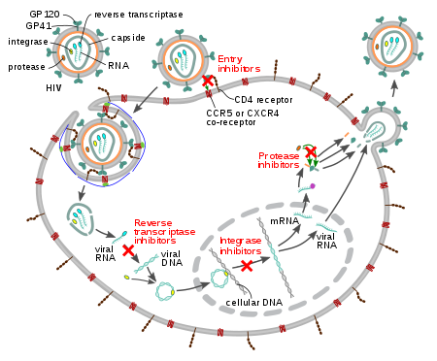
ARV - Classes
CLASS
NRTIs
  NsRTIs
NNRTIs
PIs
INSTIs
Fusion Inhibitors
CCR5 Antagonists

Slide 4
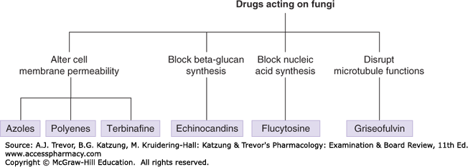
Antifungals – Classes

Slide 5
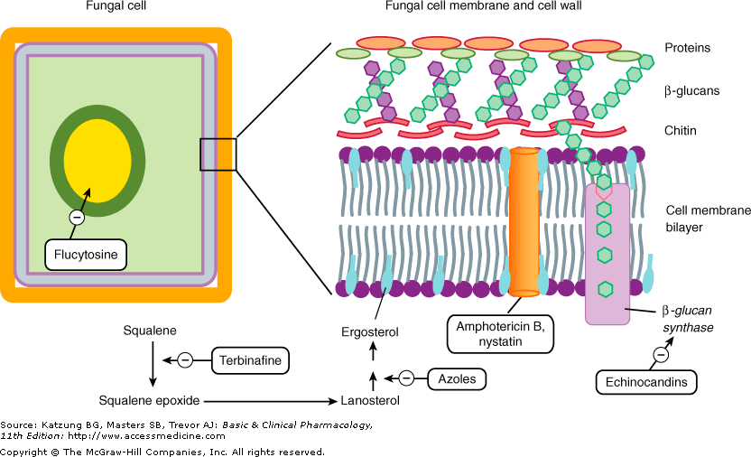
Targets of antifungal drugs

Slide 6
PHARMACOLOGY OF AMPHOTERICIN B
Chemistry -Amphotericin B is a polyene antibiotic (polyene: containing many double bonds) Mechanism of action -Binding to ergosterol present in the membranes of fungal cells ⬇ Formation of “pores” in the membrane ⬇ Leaking of small molecules (mainly K+) from the cells -The ultimate effect may be fungicidal or fungistatic depending on the organism and on drug concentration.

Slide 7
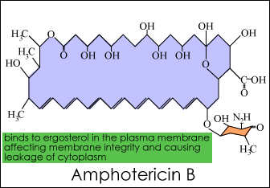

Slide 8
Antifungal spectrum and resistance
-Antifungal spectrum includes:
  Histoplasma capsulatus
  Coccidioides immitis
  Paracoccidioidoides braziliensis
  Aspergillus fumigatus
  Blastomyces dermatitidis
  Cryptococcus neoformans
  Candida albicans
  Sporothrix schenckii
  Mucor and Rhizopus spp
  Resistance may occur but is very rare

Slide 9
Pharmacokinetics
-F(oral): < 1% (too irritant to be given IM)
-Distribution in all body tissues, except CNS and eye
(concentrations in CSF are <10% than in plasma; however therapeutic concentrations in CNS can usually be achieved with parenteral administration)
-Biotransformation: > 95%
-Renal excretion: < 5%
-Half life: » 14 days
Drug formulations and administration
-Formulations:
a) complex with deoxycholate
b) liposomal complex (adverse effects seem diminished)
-Administration:
IV infusion, intrathecal, topical, oral (to treat intestinal mycoses)

Slide 10
Adverse effects
(the therapeutic index of the drug is very narrow) -Headache, arthralgias, nausea and vomiting fever and chills, hyperpnea, shock-like fall in blood pressure (they may appear during IV infusion and may be reduced by concomitant administration of antipyretics or meperidine) -Malaise, weight loss -Nephrotoxicity (azotemia , decreased GFR, renal tubular acidosis, renal wasting of K+ and Mg++,). It is common (up to 80% of patients) and may be severe -Normocytic anemia, likely due to decreased production of erythropoietin (frequent) -Thrombophlebitis -Delirium, seizures (after intrathecal injection)

Slide 11
PHARMACOLOGY OF ANTIFUNGAL AZOLES
Chemistry -Imidazole derivatives: ketoconazole, miconazole, econazole, clotrimazole -Triazole derivatives: itraconazole, fluconazole. Mechanism of action -Inhibition of sterol 14-alpha-demethylase, a cytochrome P450-dependent enzyme (relative selectivity occurs because the affinity for mammalian P450 isozymes is less than that for the fungal isozyme) ⬇ blockade of the synthesis of ergosterol in fungal cell membranes -The ultimate effect may be fungicidal or fungistatic depending on the organism and on drug concentration.

Slide 12
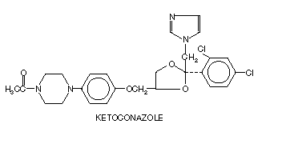
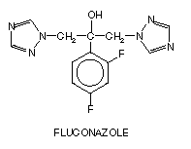
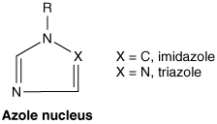
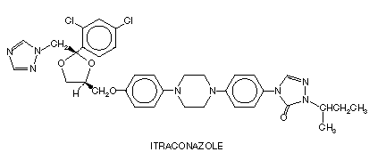

Slide 13
Antifungal spectrum and resistance
-Antifungal spectrum includes: Histoplasma capsulatus, Coccidioides immitis Paracoccidioidoides braziliensis , Aspergillus fumigatus Blastomyces dermatitidis, Cryptococcus neoformans Candida albicans , Sporothrix schenckii Dermatophytes (Microsporum, Epidermophyton, Trichophyton, Malassezia furfur) -Resistance can occur but is rare. -Cross-resistance between azoles is a common finding.
Other effects
-Azoles may inhibit certain mammalian cytochrome P450 isozymes and therefore they may 1) inhibit the synthesis of androgens and of corticosteroids 2) potentiate the effects of several drugs including cyclosporine, phenytoin, terfenadine, astemizole, tolbutamide and warfarin.

Slide 14
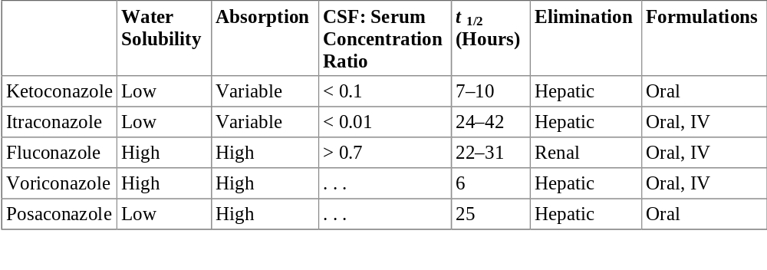
Pharmacologic properties of five systemic azole drugs

Slide 15
Pharmacokinetics and administration
-F(oral): itraconazole » 55%,
Adverse effects
-Anorexia, nausea and vomiting (they are dose-dependent and patients receiving high doses may require antiemetics) -Gynecomastia, decreased libido, impotence, menstrual irregularities (with ketoconazole, due to blockade of adrenal steroid synthesis) -Hepatitis (is rare, but can be fatal) -Hypokalemia, hypertension (itraconazole) -Azoles are potent teratogenic drugs in animals

Slide 16
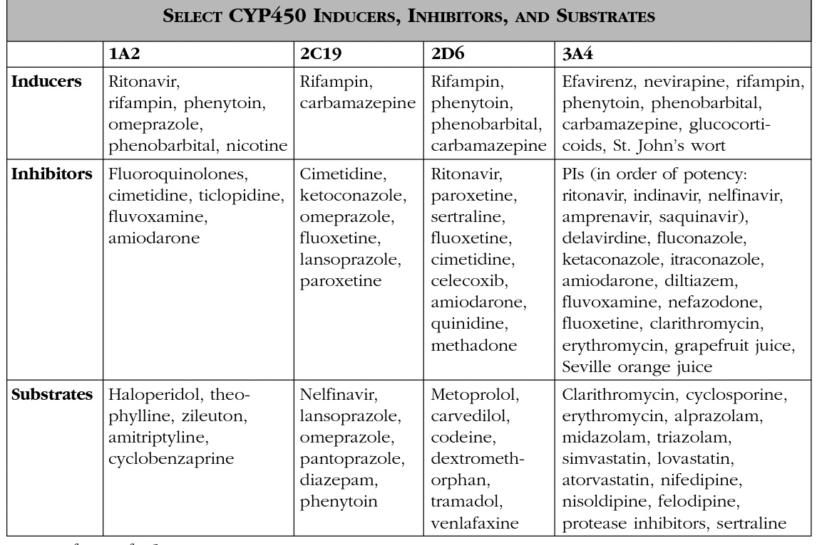
Drug Interaction Types

Slide 17
Interactions – Amph B
ARV/ Drug | Effect on drug | Effect on Amph B | Clinical Effects | Mechanism of interactn | Mgt
TDF | --- | --- | Increased risk of nephrotoxicity | Kidney damage | Avoid; monitor closely.
3TC | --- | --- | Increased risk of nephrotoxicity | Kidney damage | Monitor closely; ↓ 3TC if renal fxn deteriorates
Fluconazole | ↑ | ↑ | Beneficial |  | Monitor for toxicity
Itraconazole | ↓ | ↔/ ↑ | Itraconazole treatment failure | -- | ↑ risk of renal toxicity

Slide 18
Interactions - Itraconazole
ARV | Effect on ARVs | Effect on Antifungal | Clinical Effects | Mechanism of interaction | Mgt
EFV | -- | AUC ↓(≈39%); Cmax ↓(≈37%) | ↓ effects of Itra | Induction of CYP450 3A4 by EFV | Do not co-administer
ETG/c | ±↑ | ±↑ | --- | --- | Avoid, except if necessary
PIs | ±↑ | ±↑ | ↑ effects of both | Inhibition of CYP450 3A4 by both | Avoid; if needed, limit Itra dose to < 200mg/d
NVP | -- | ↓ | Best avoided |  | Monitor Itraconazole levels, and ±↑ dose

Slide 19
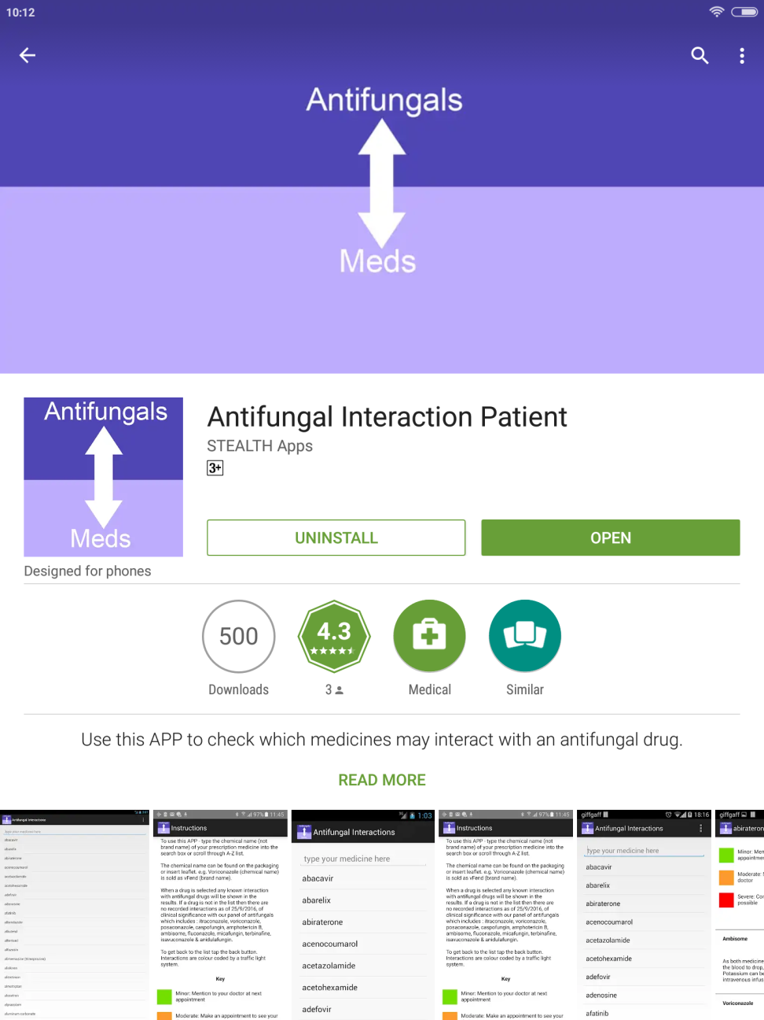
Antifungal interaction App

Slide 20
Online resource for drug interaction
https://www.hiv-druginteractions.org/checker
https://antifungalinteractions.org/

Slide 21
Thank you!!

Slide 22
References
Leading International Fungal Education (LIFE). Cryptococcal Infection. http://www.life-worldwide.org/fungal-diseases/cryptococcal-meningitis
CDC Training manual on histoplasmosis. https://www.cdc.gov/fungal/diseases/cryptococcosis-neoformans/index.html
.

